Slide 1
ANNOUNCEMENTS
Midterm next week!
Tuesday at 4:30pm
Please read over these:
https://www.theglobeandmail.com/canada/article-climate-fuelled-flooding-is-canadas-costliest-and-fastest-growing/
http://www.cbc.ca/news/canada/new-brunswick/water-levels-flood-new-brunswick-1.4652929
http://www.cbc.ca/news/canada/british-columbia/evacuation-boundary-region-flooding-1.4656616
https://muse-jhu-edu.libaccess.lib.mcmaster.ca/article/593193/pdf

Slide 2
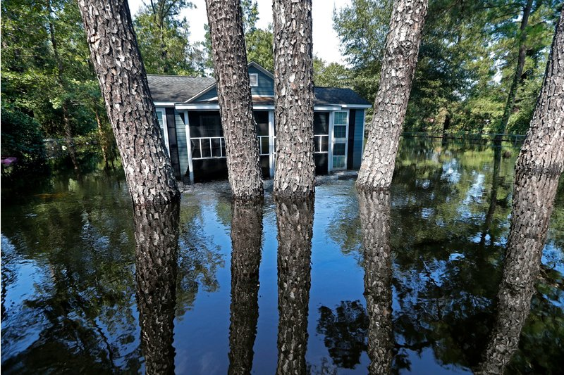
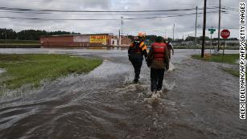
In the News
Indonesian Tsunami
City of Palu
Over 1200 fatalities with number growing
Hurrican Florence
Giant Mosquitos
secondary impacts

Slide 3
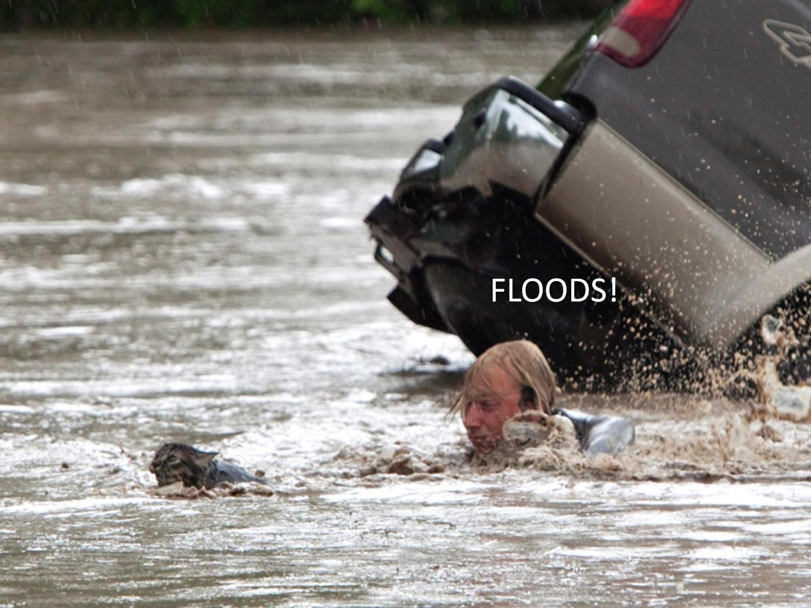

Slide 4
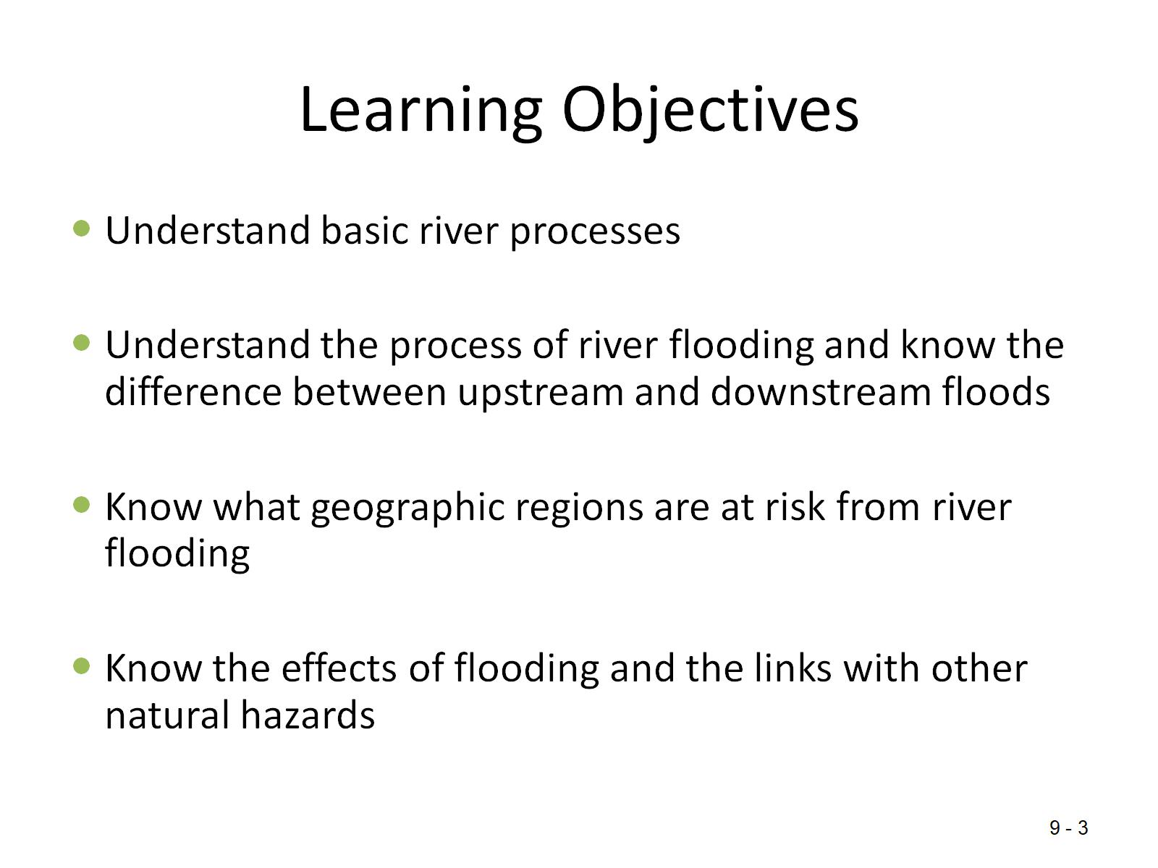
Learning Objectives

Slide 5
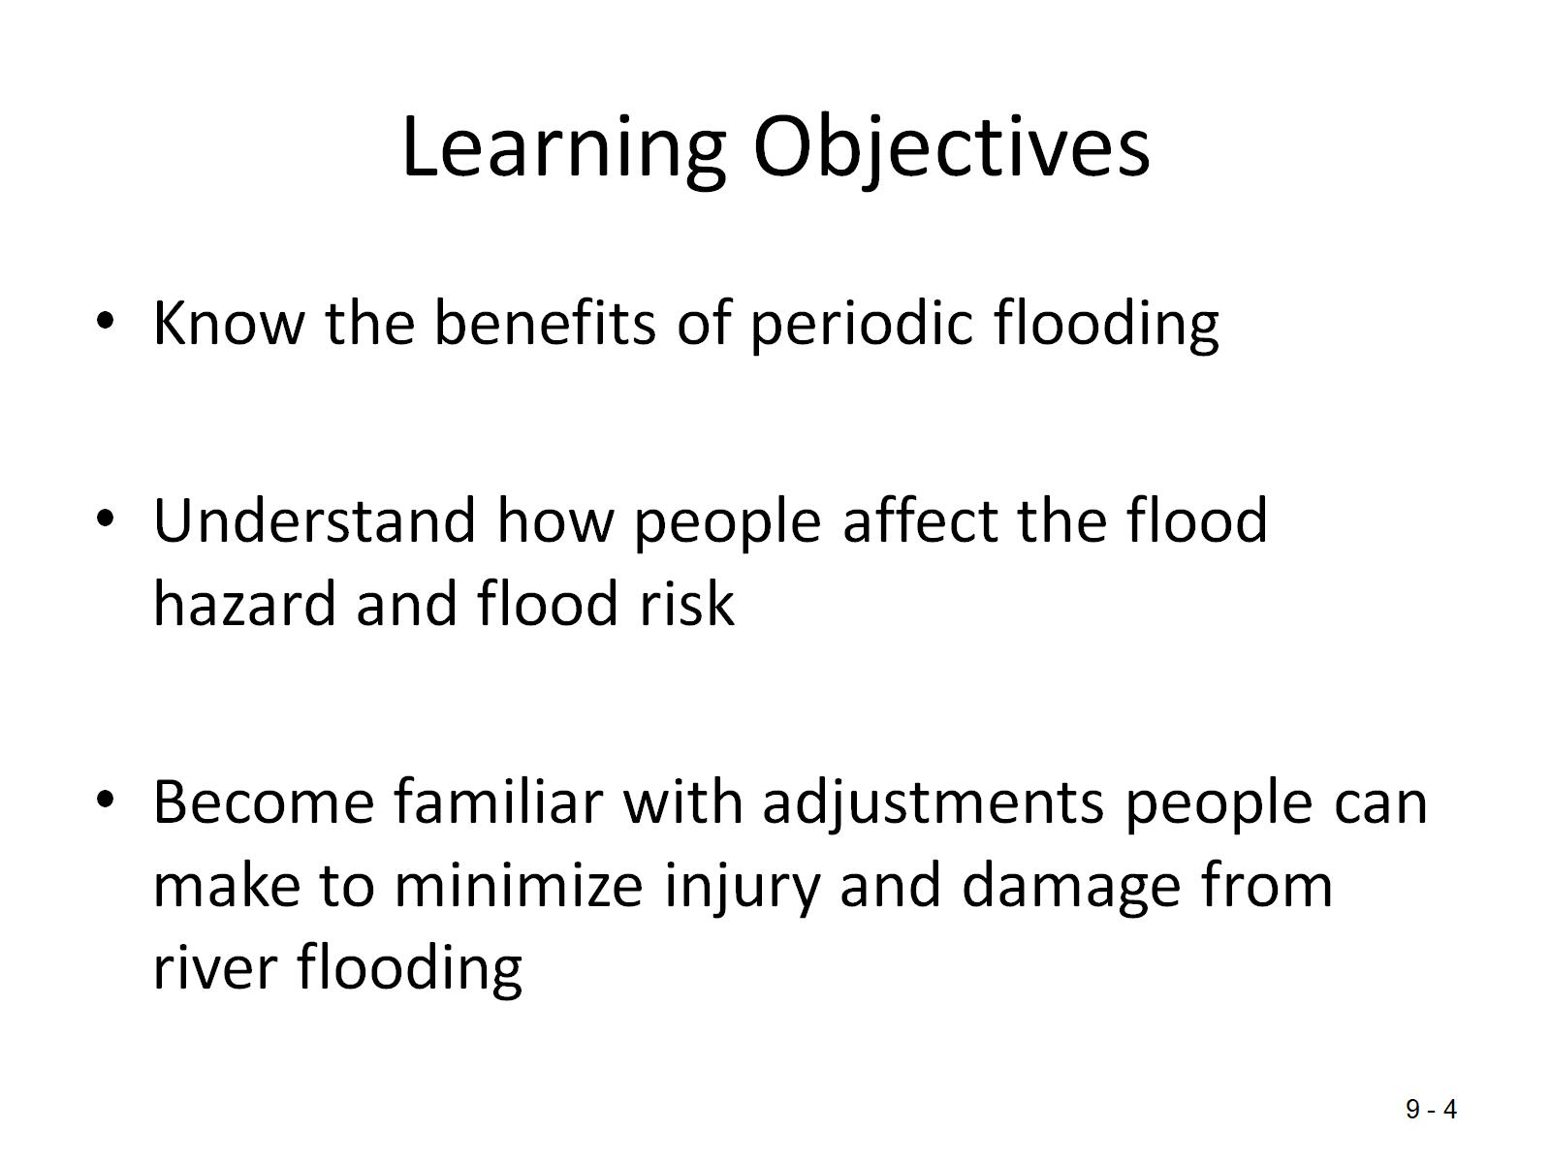
Learning Objectives

Slide 6
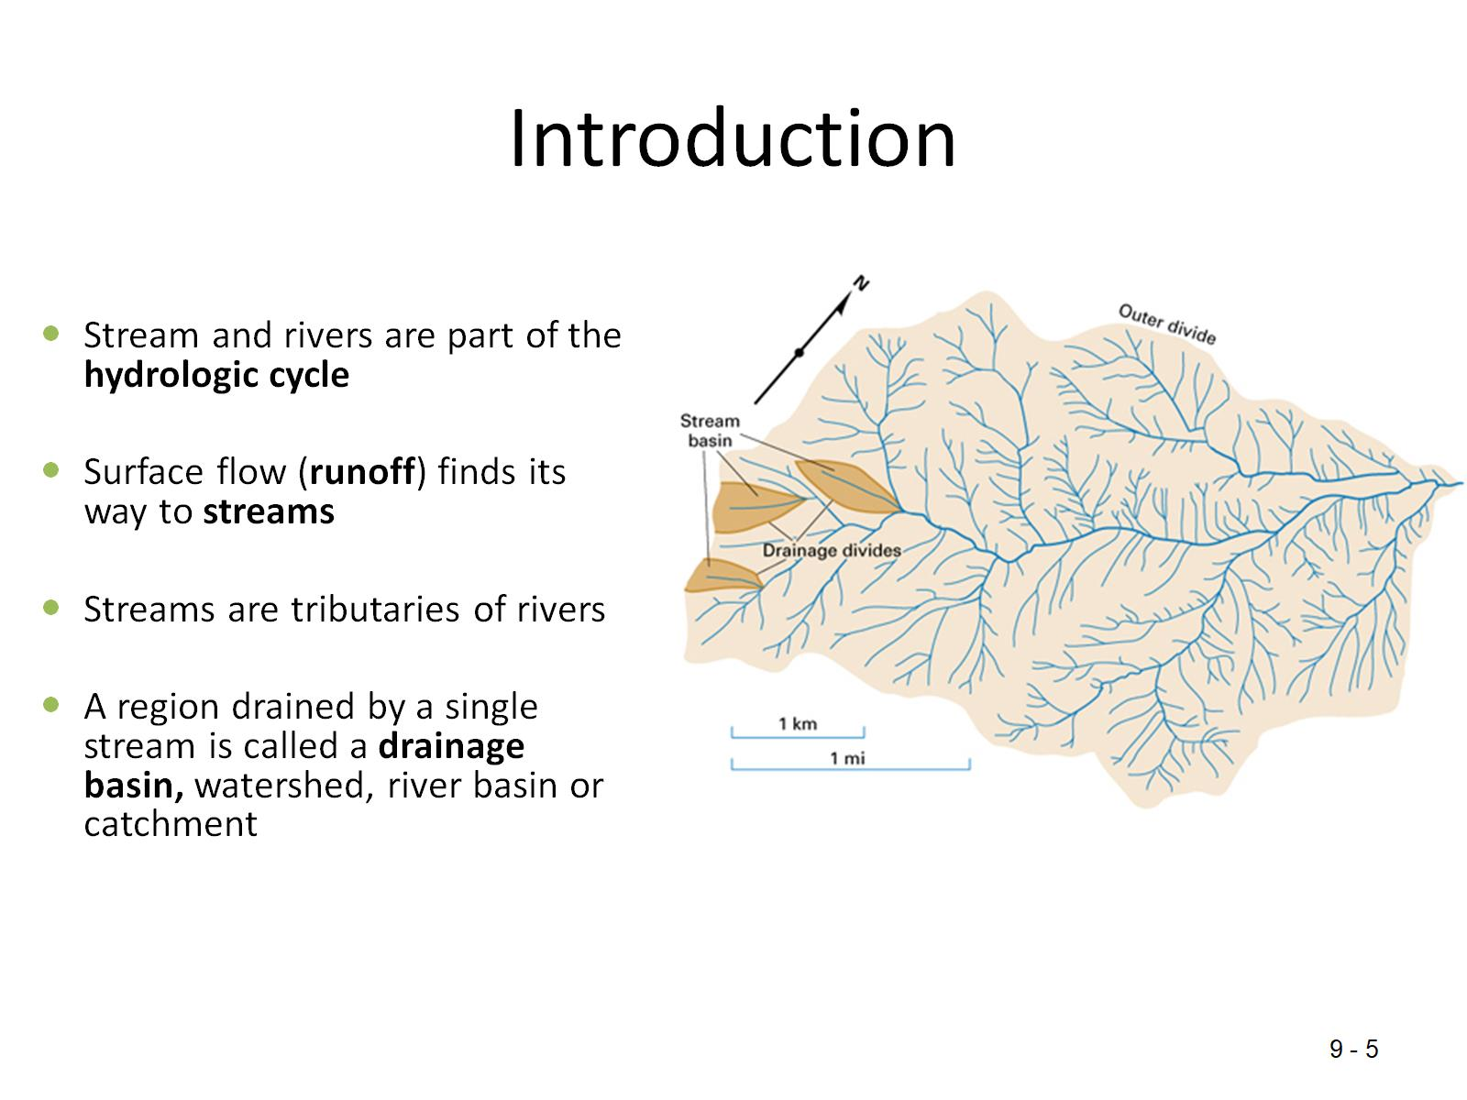
Introduction

Slide 7
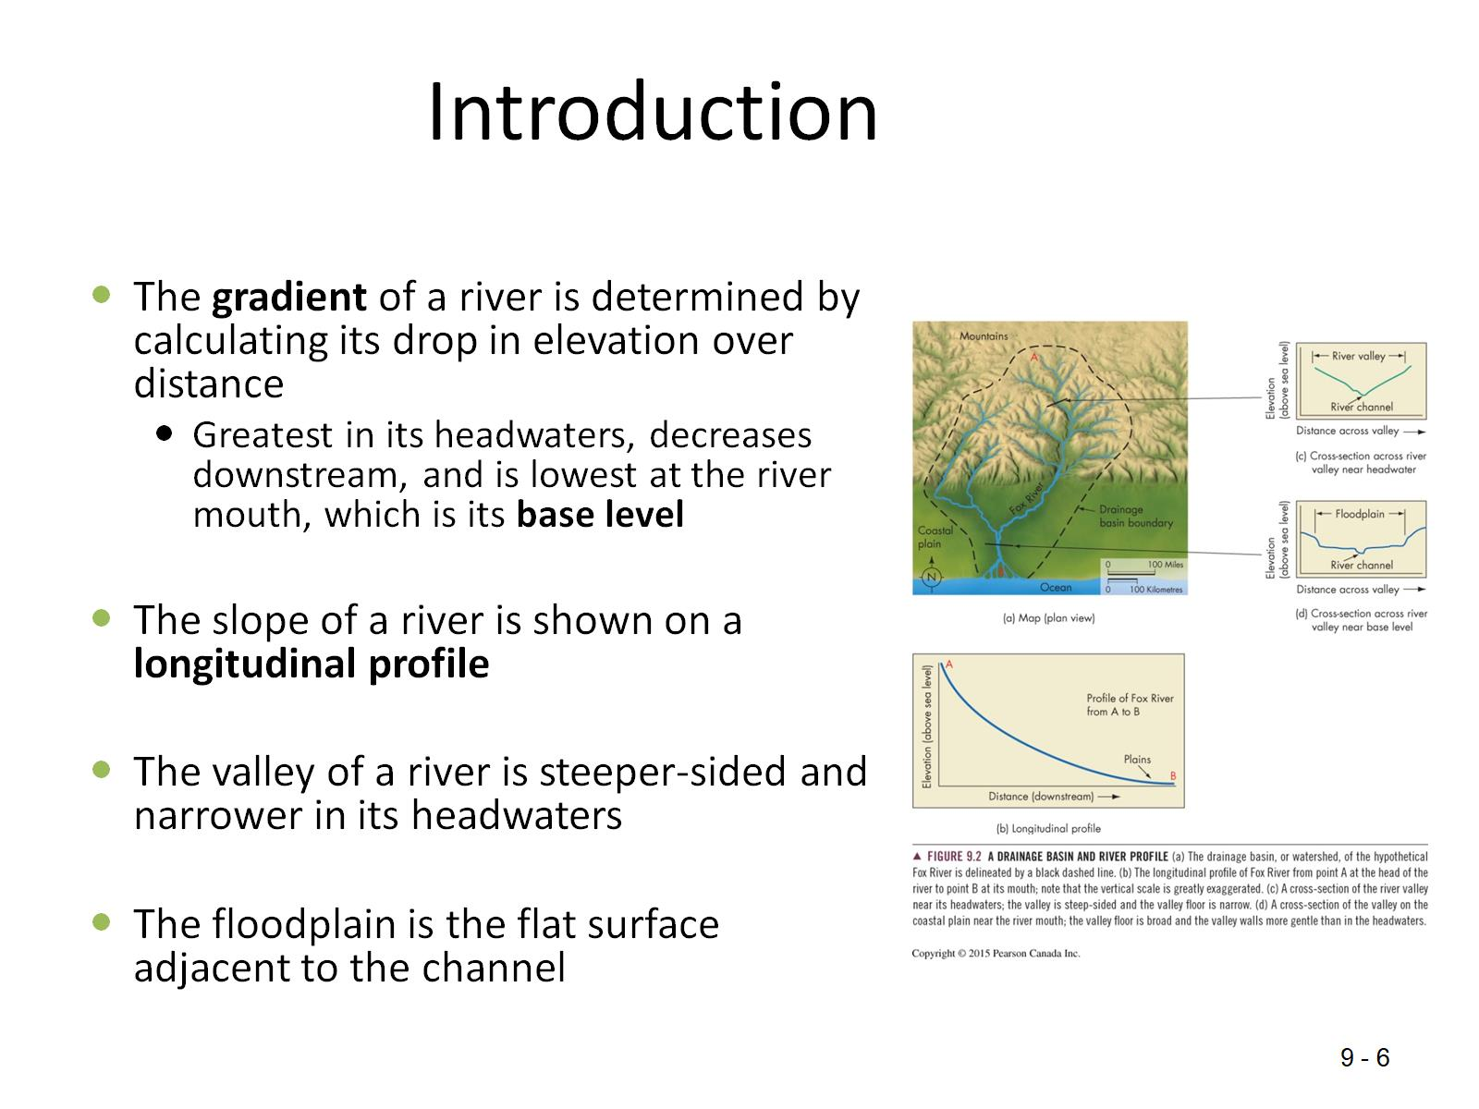
Introduction

Slide 8
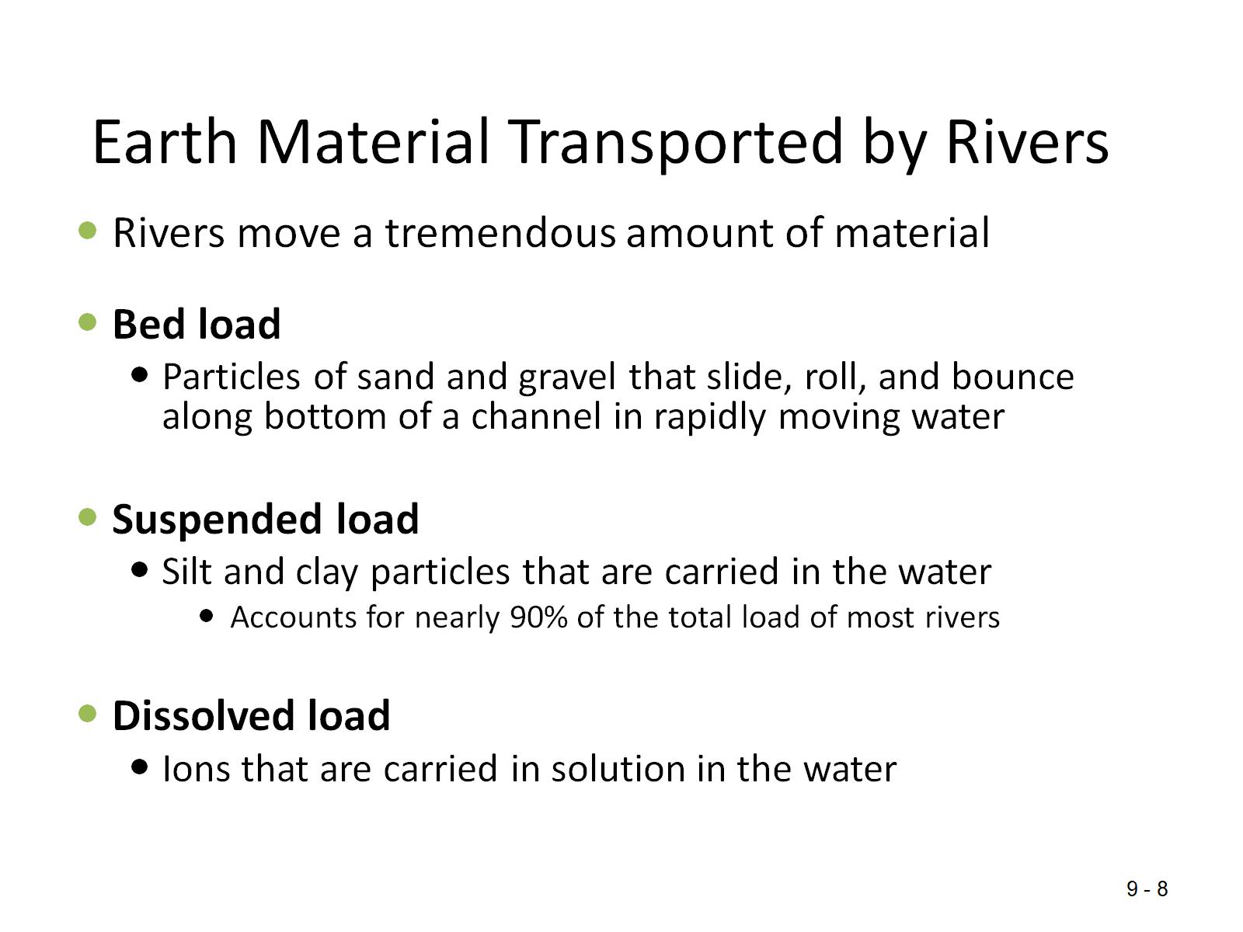
Earth Material Transported by Rivers

Slide 9
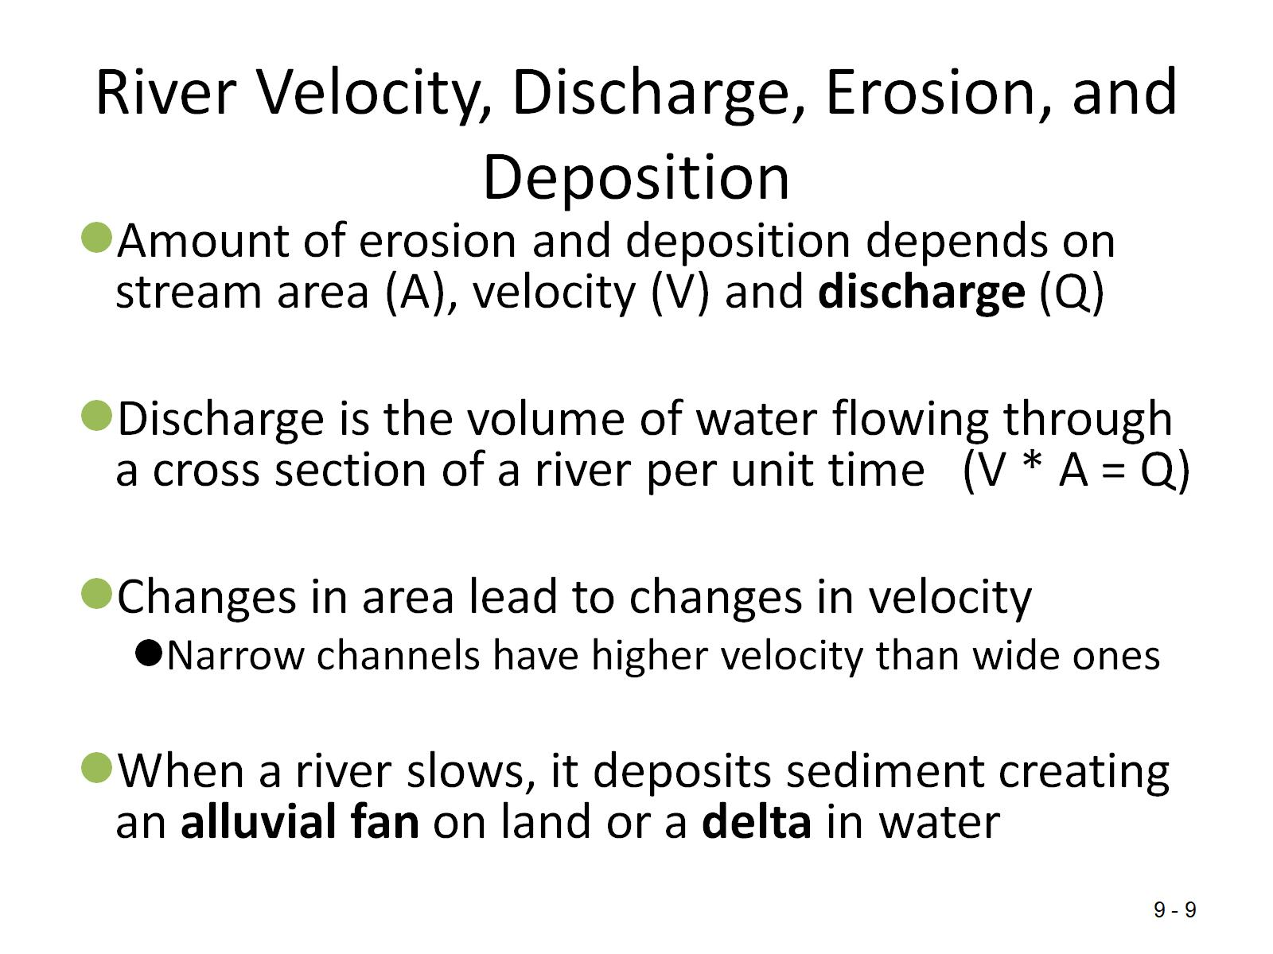
River Velocity, Discharge, Erosion, and Deposition

Slide 10
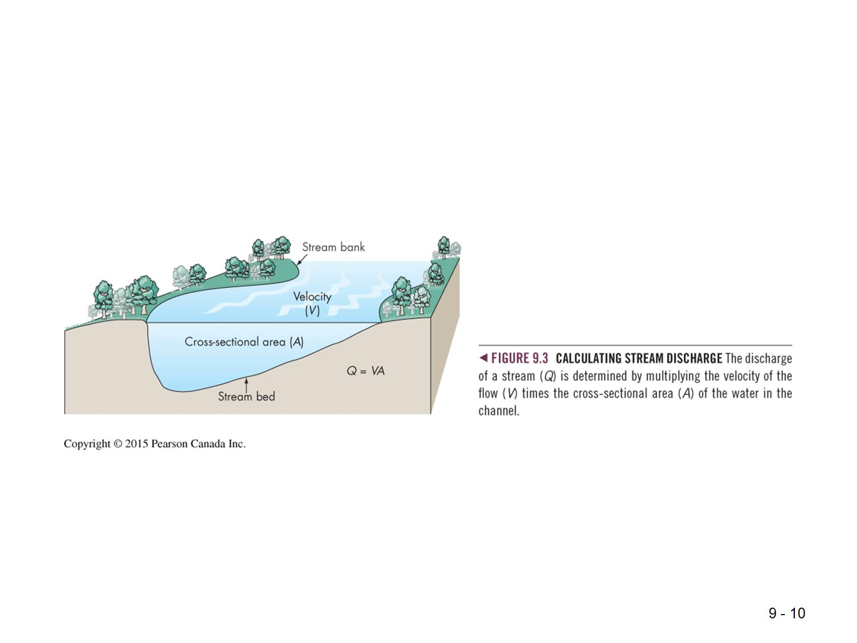

Slide 11
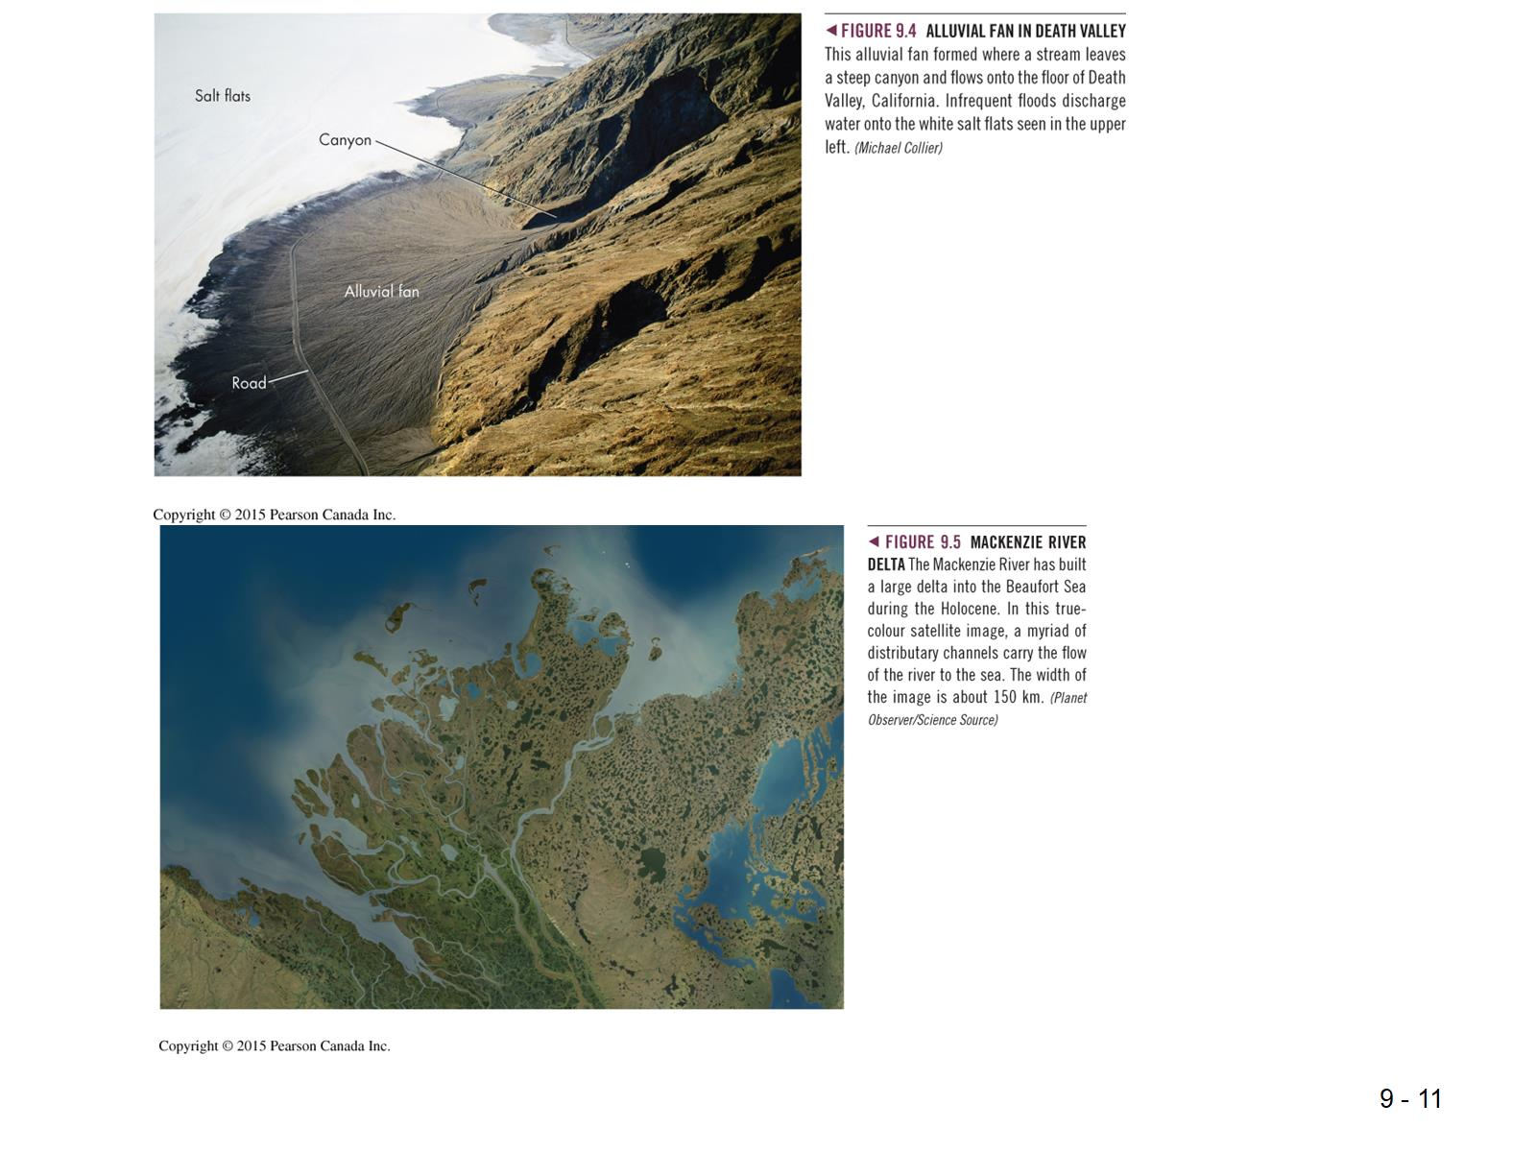

Slide 12
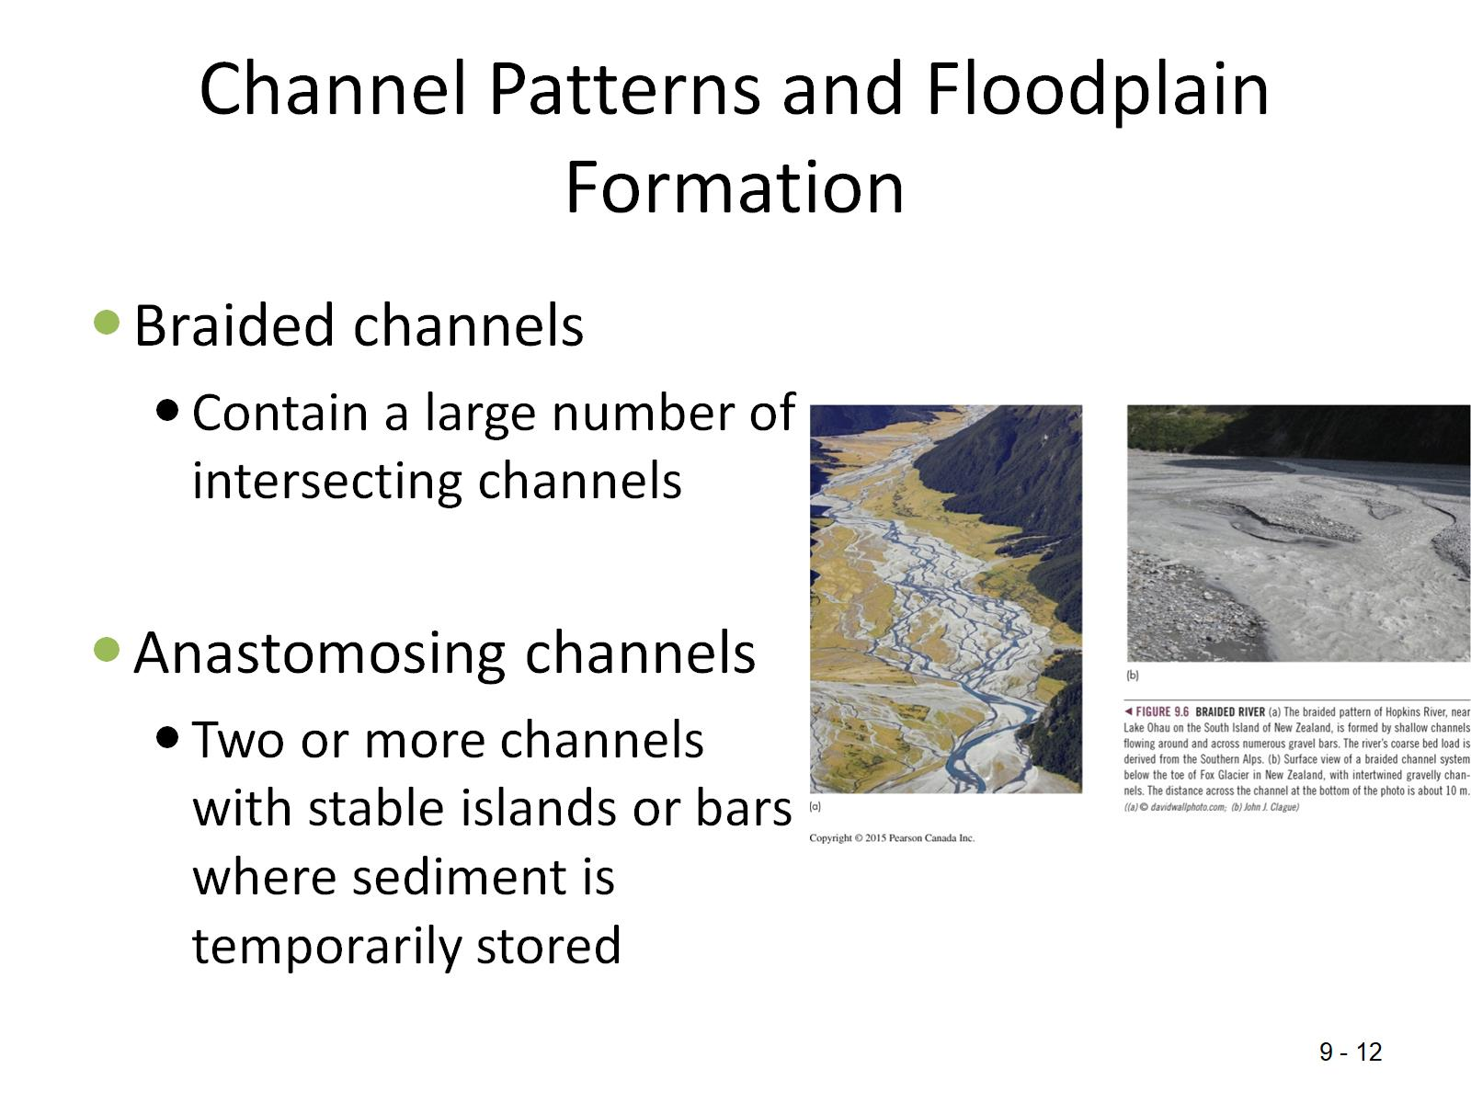
Channel Patterns and Floodplain Formation

Slide 13
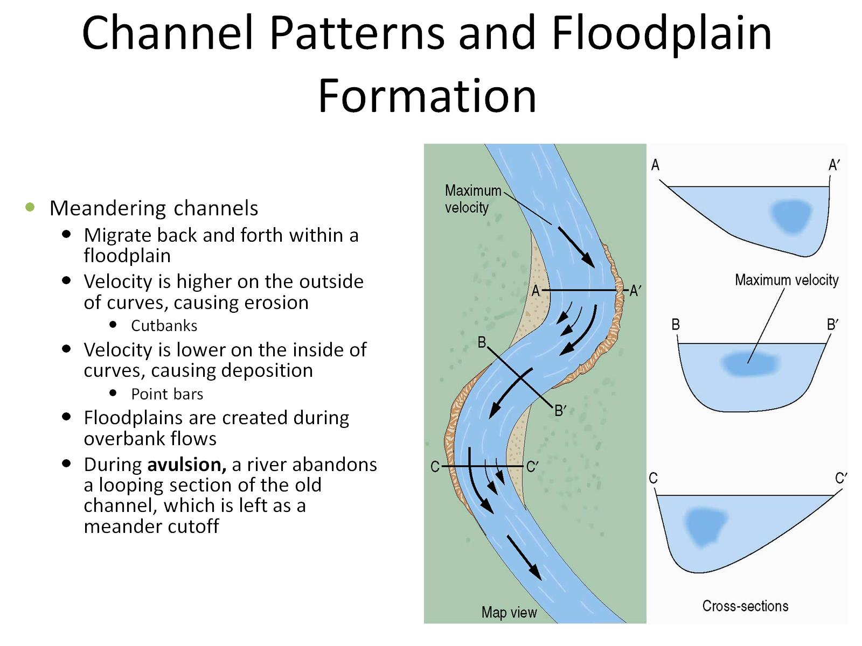
Channel Patterns and Floodplain Formation

Slide 14
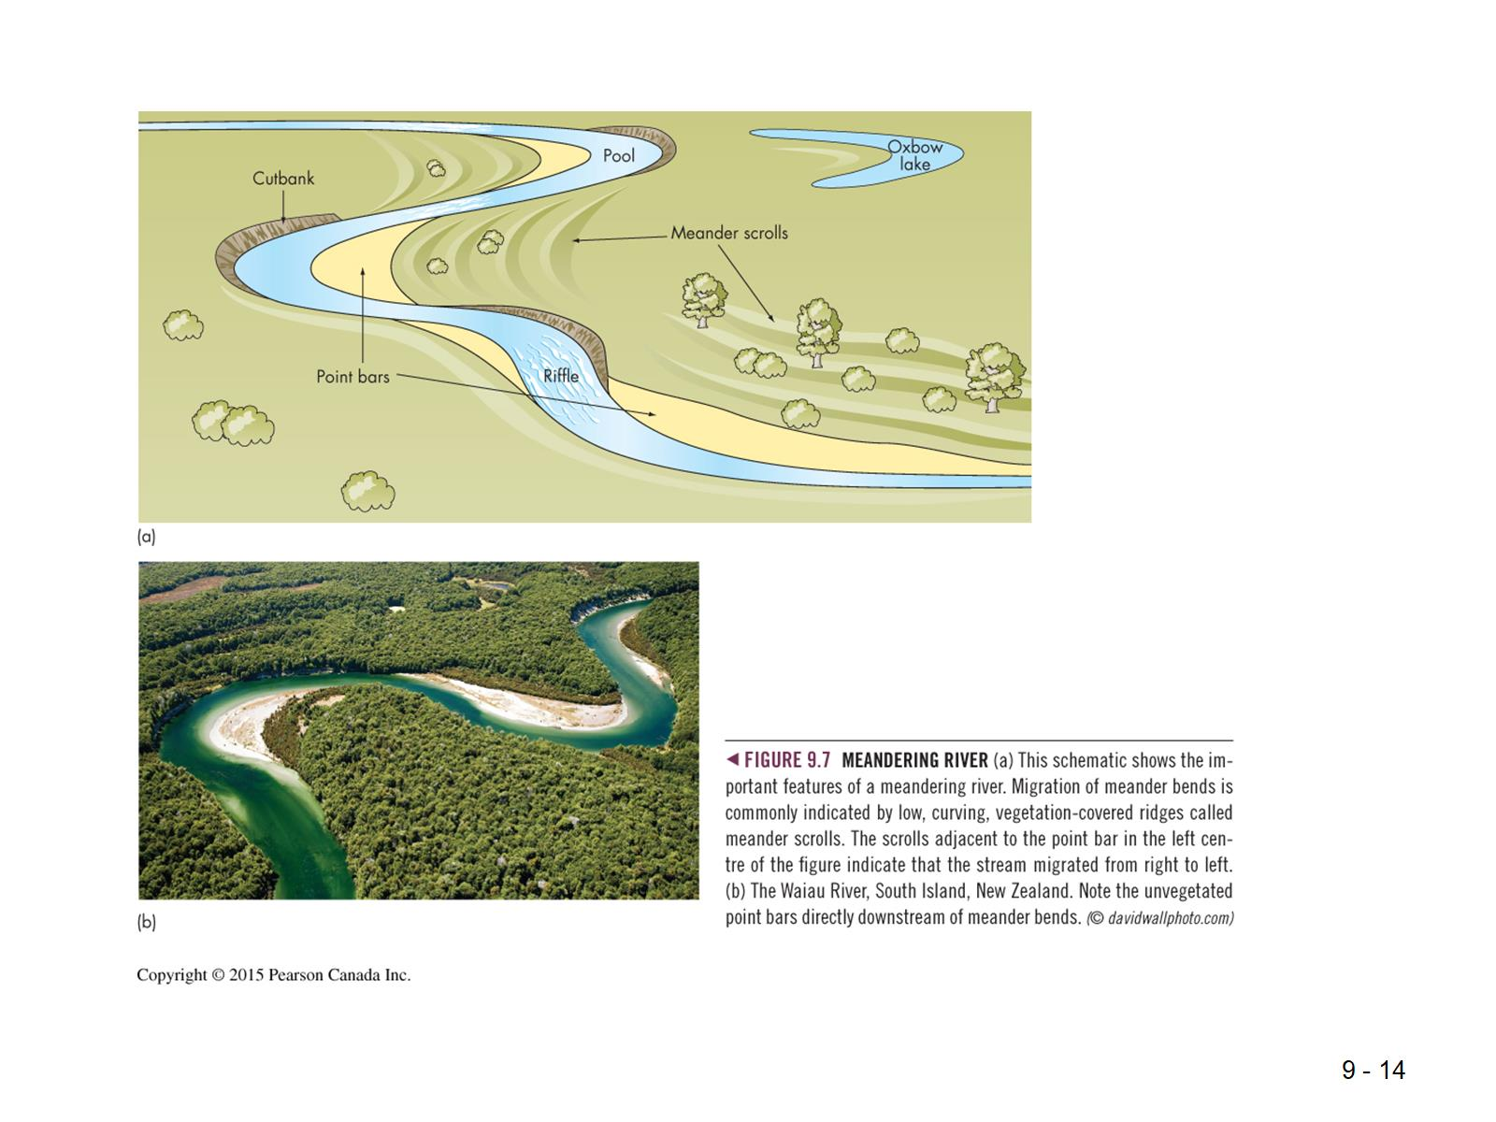

Slide 15
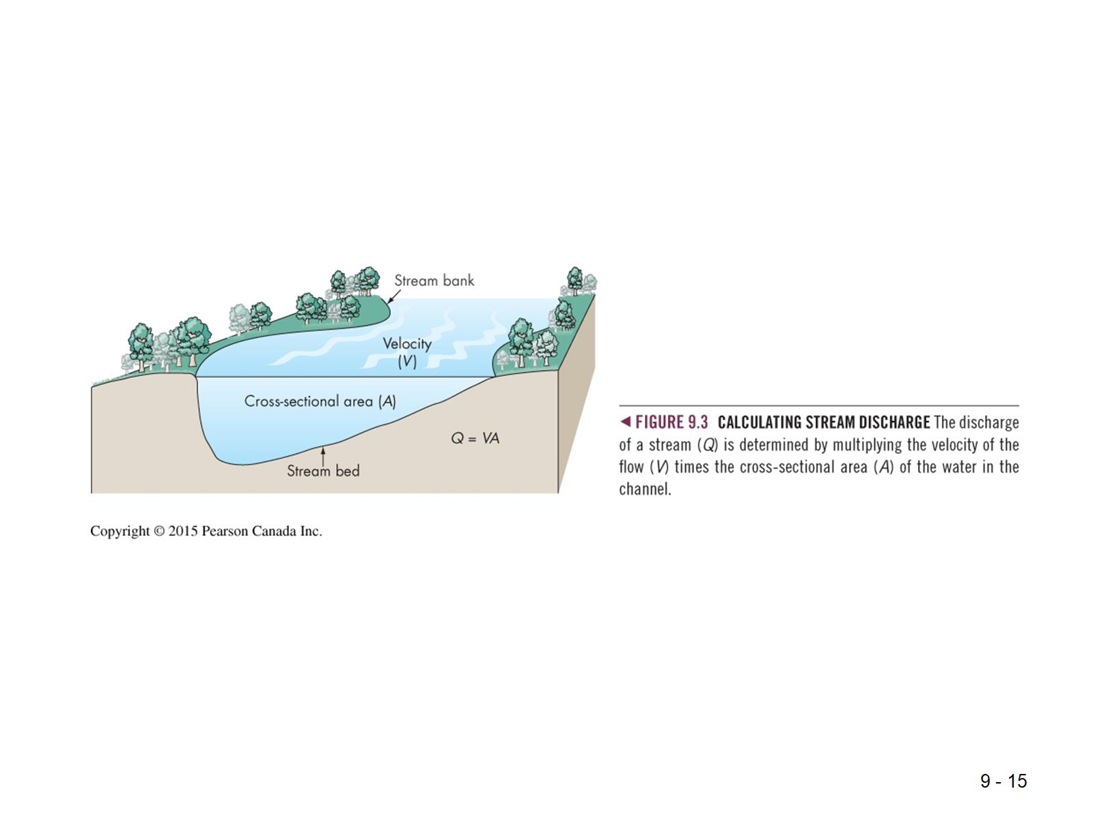

Slide 16
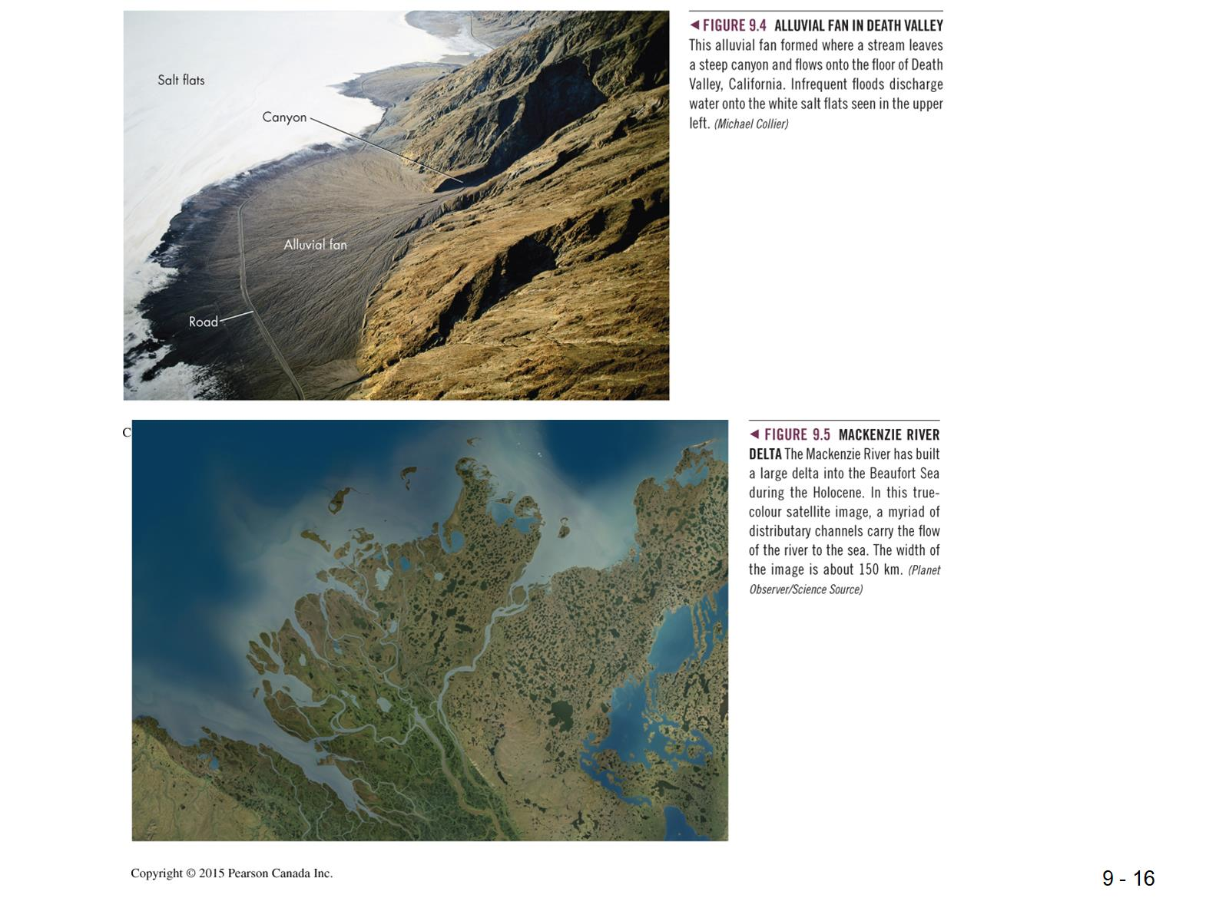

Slide 17
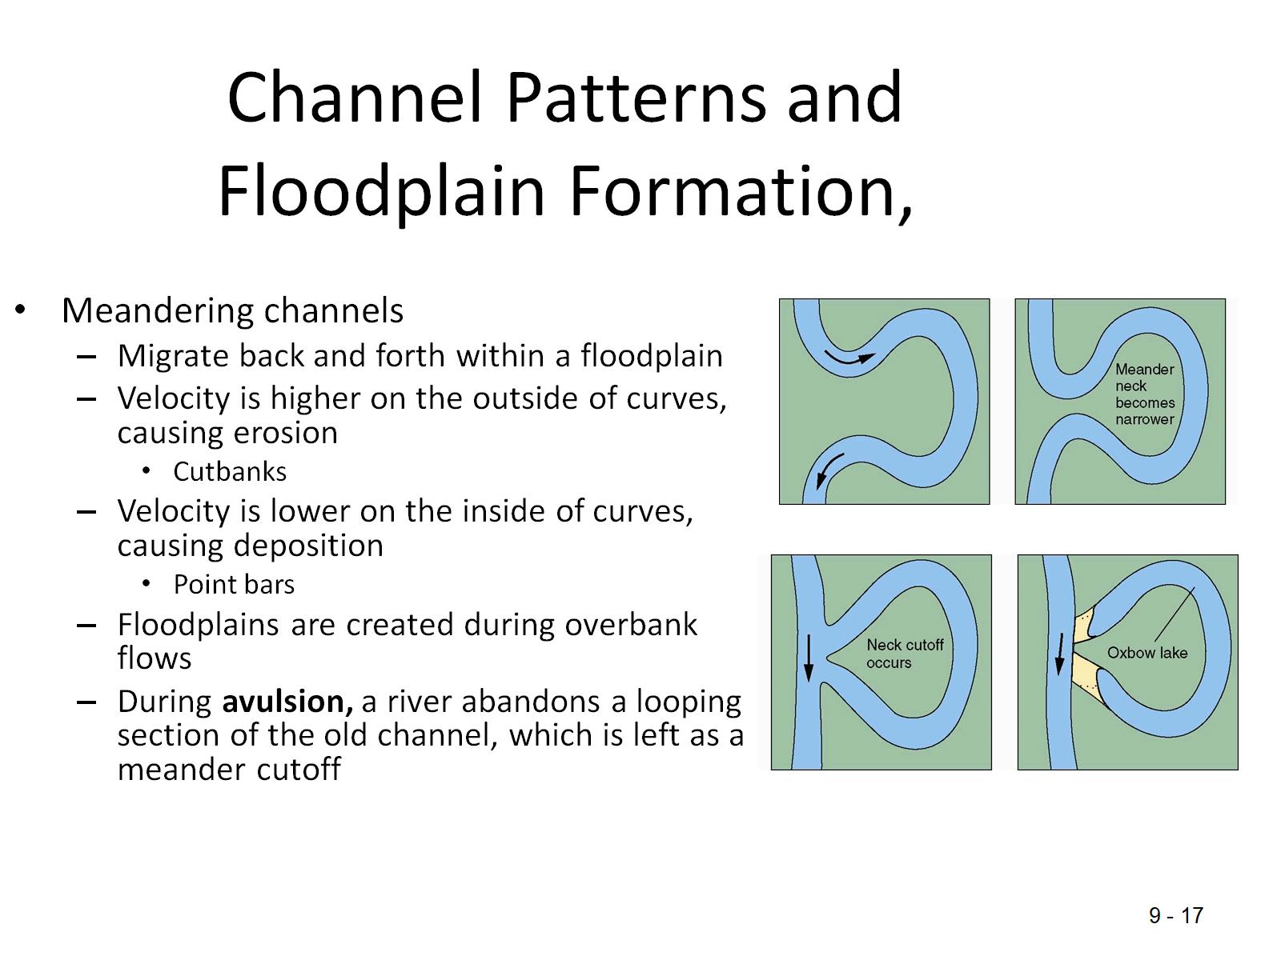
Channel Patterns and Floodplain Formation,

Slide 18
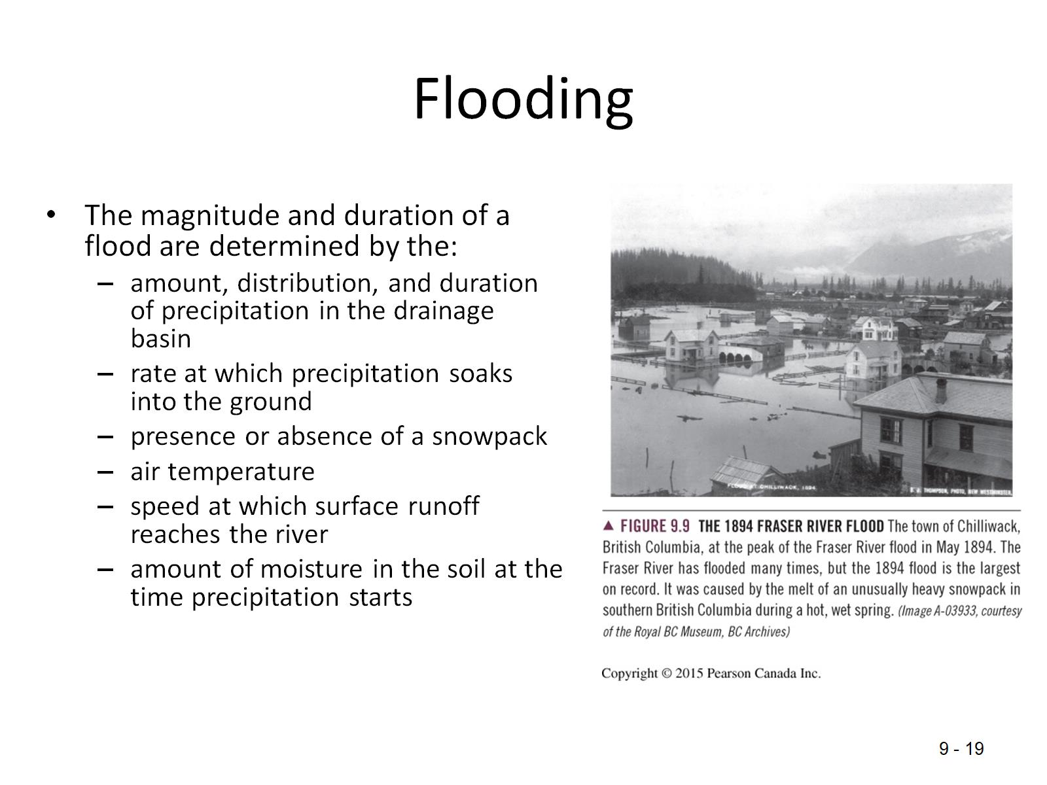
Flooding

Slide 19
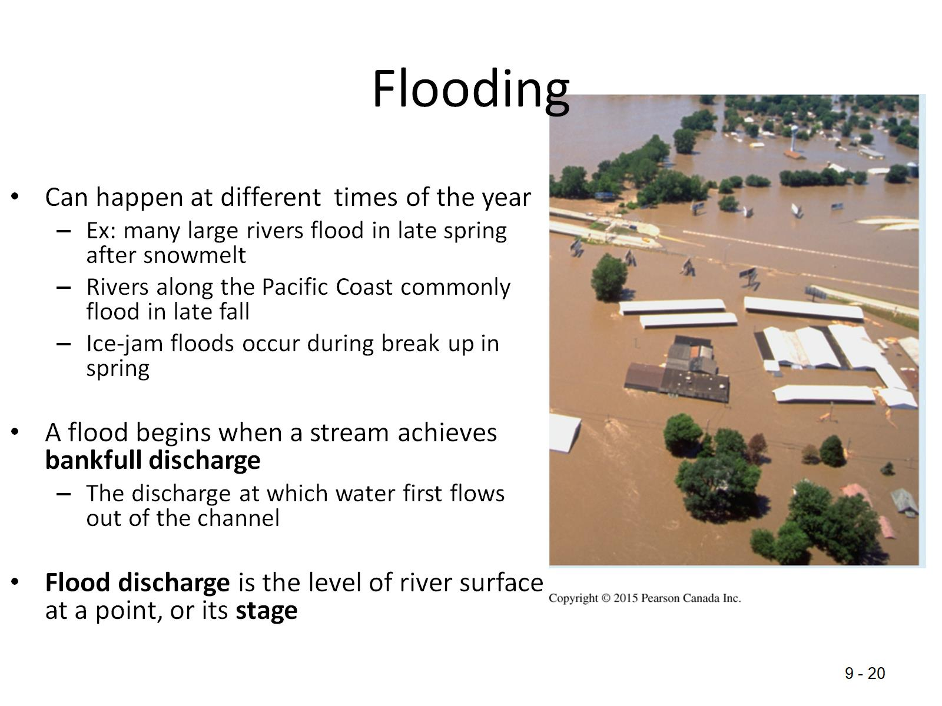
Flooding

Slide 20
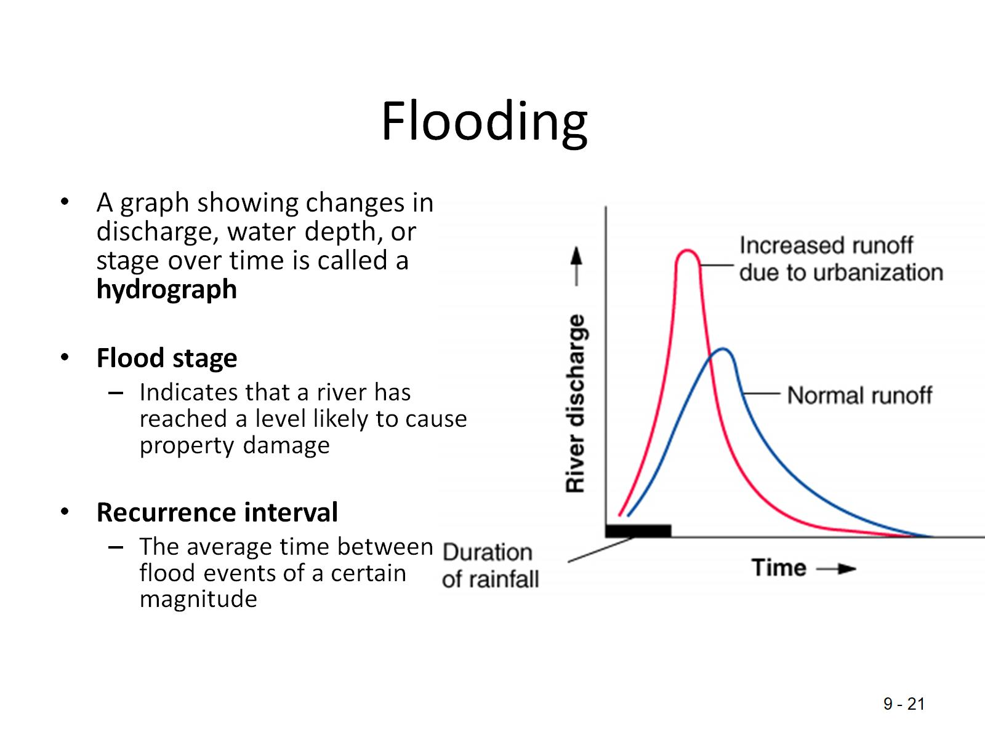
Flooding

Slide 21


Slide 22
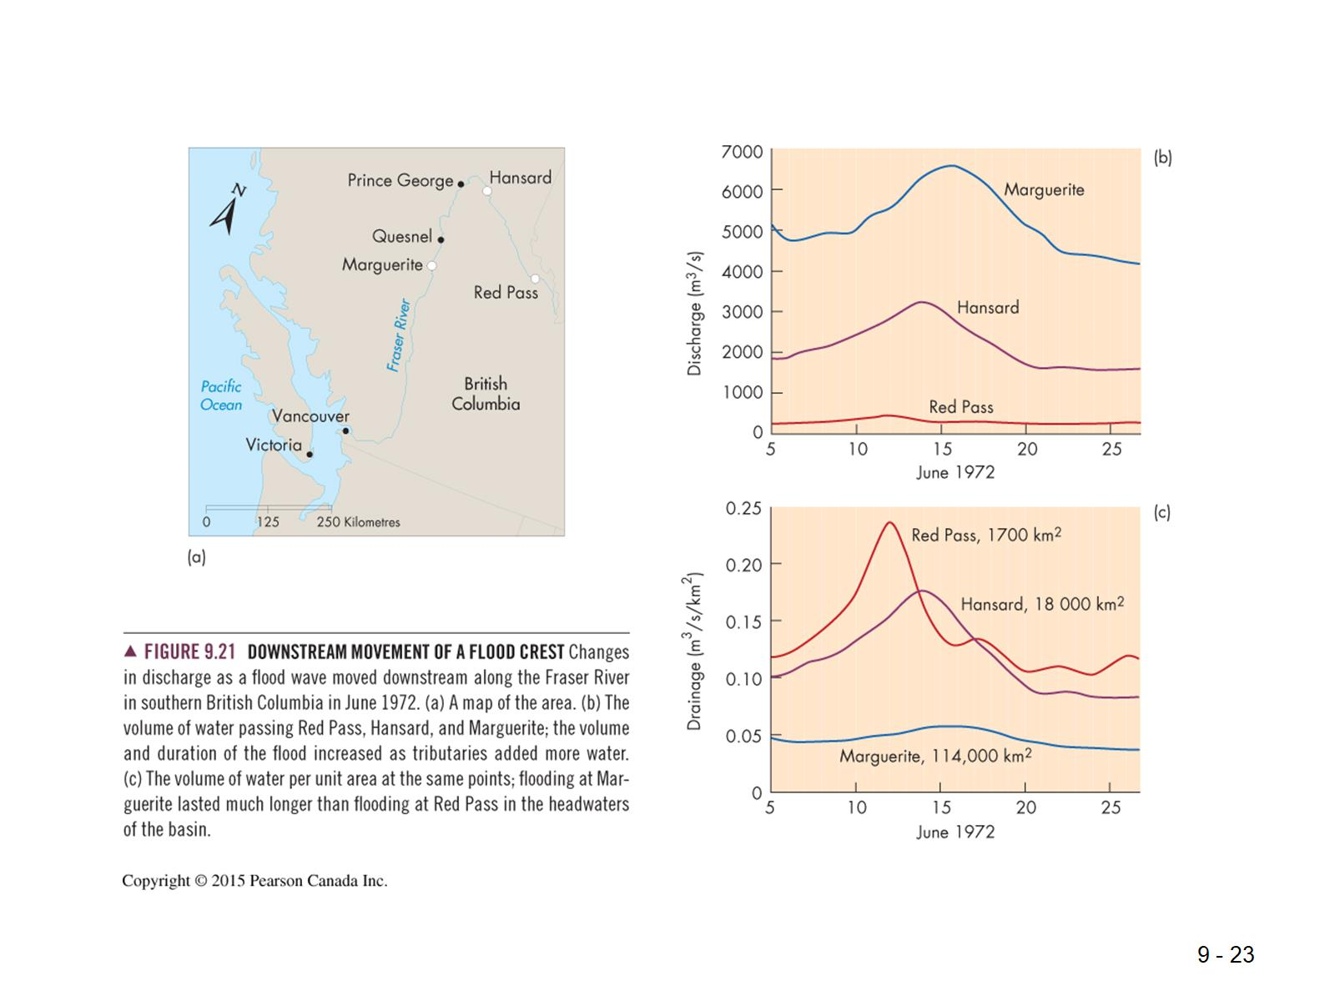

Slide 23
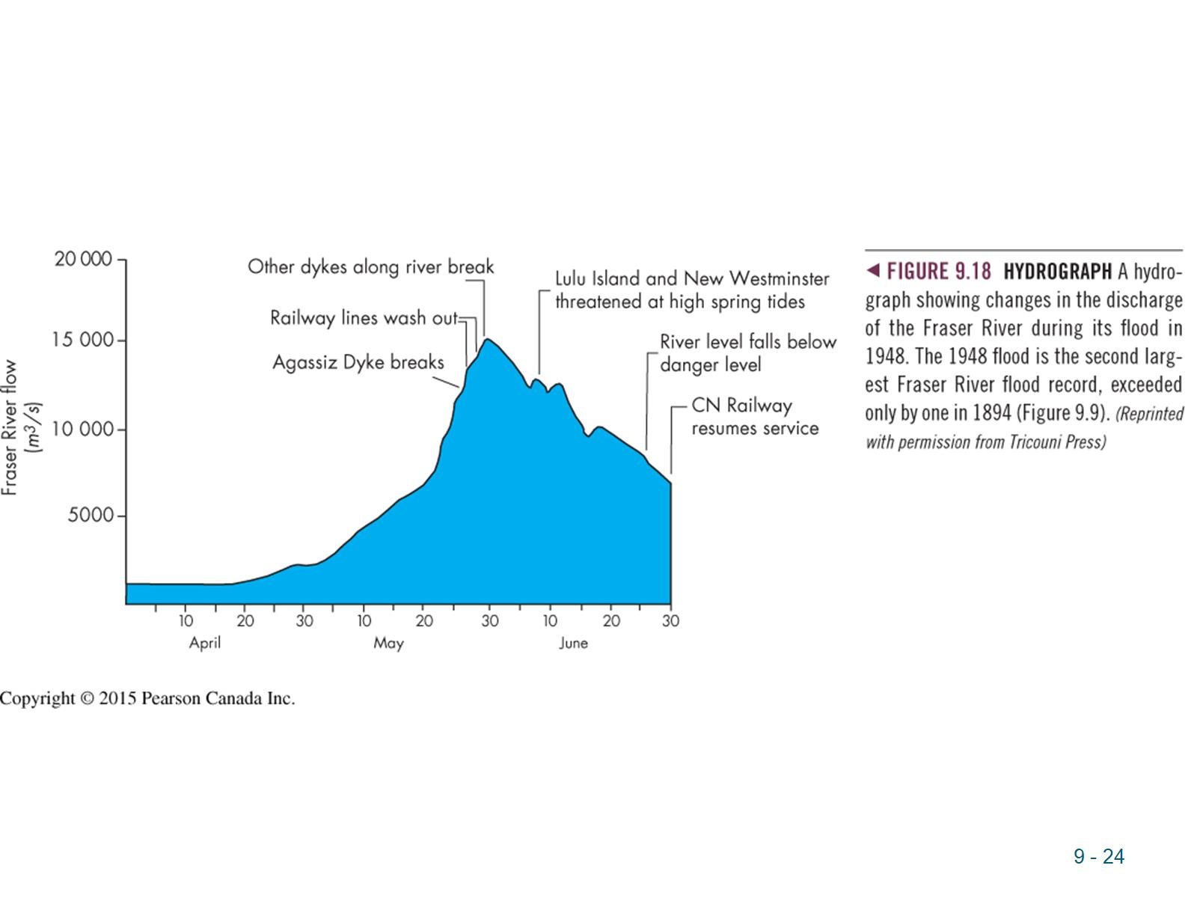

Slide 24
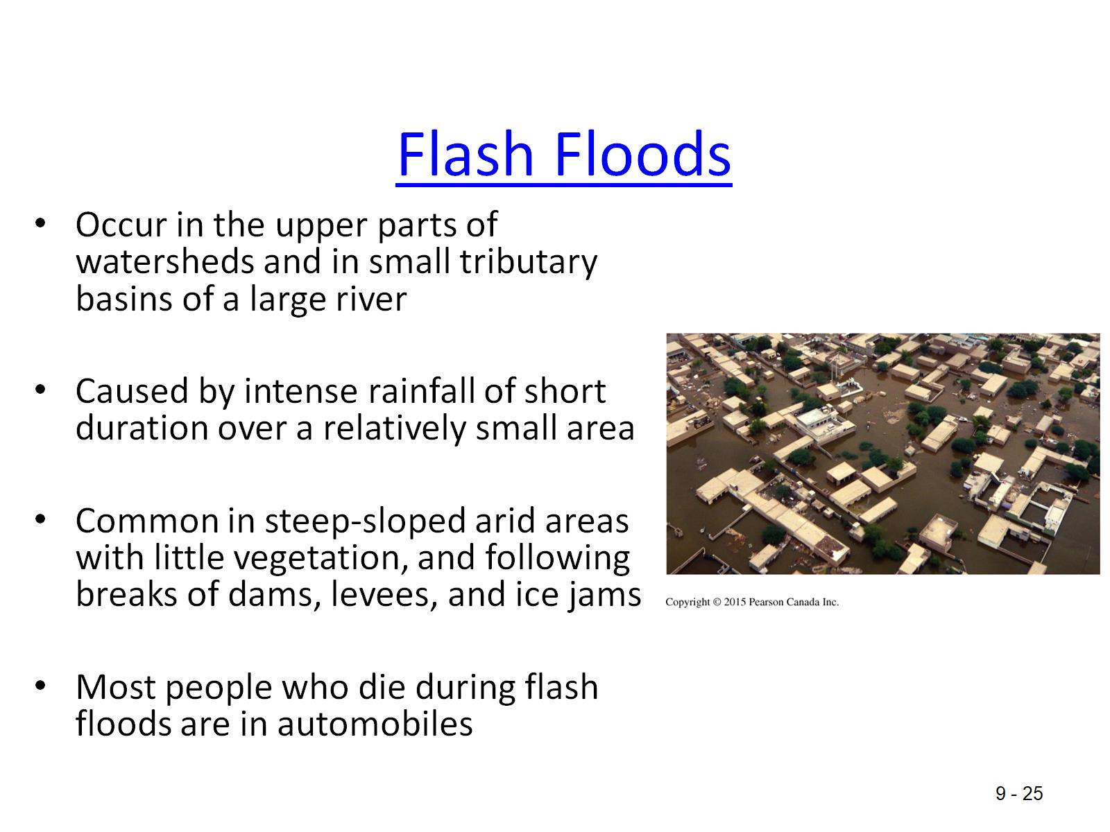
Flash Floods

Slide 25
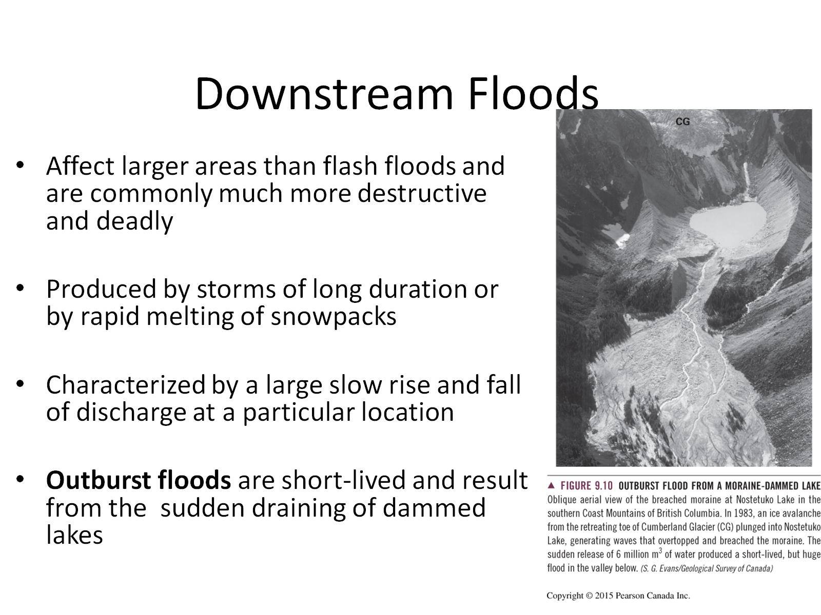
Downstream Floods

Slide 26
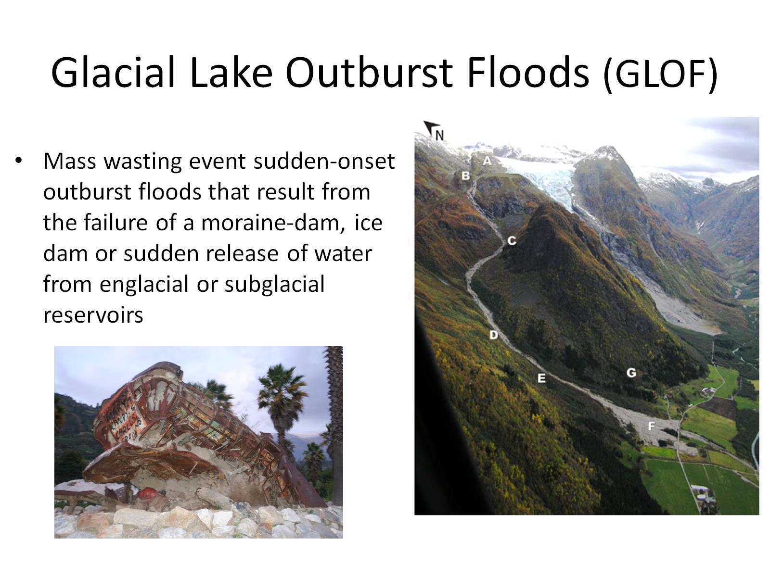
Glacial Lake Outburst Floods (GLOF)

Slide 27
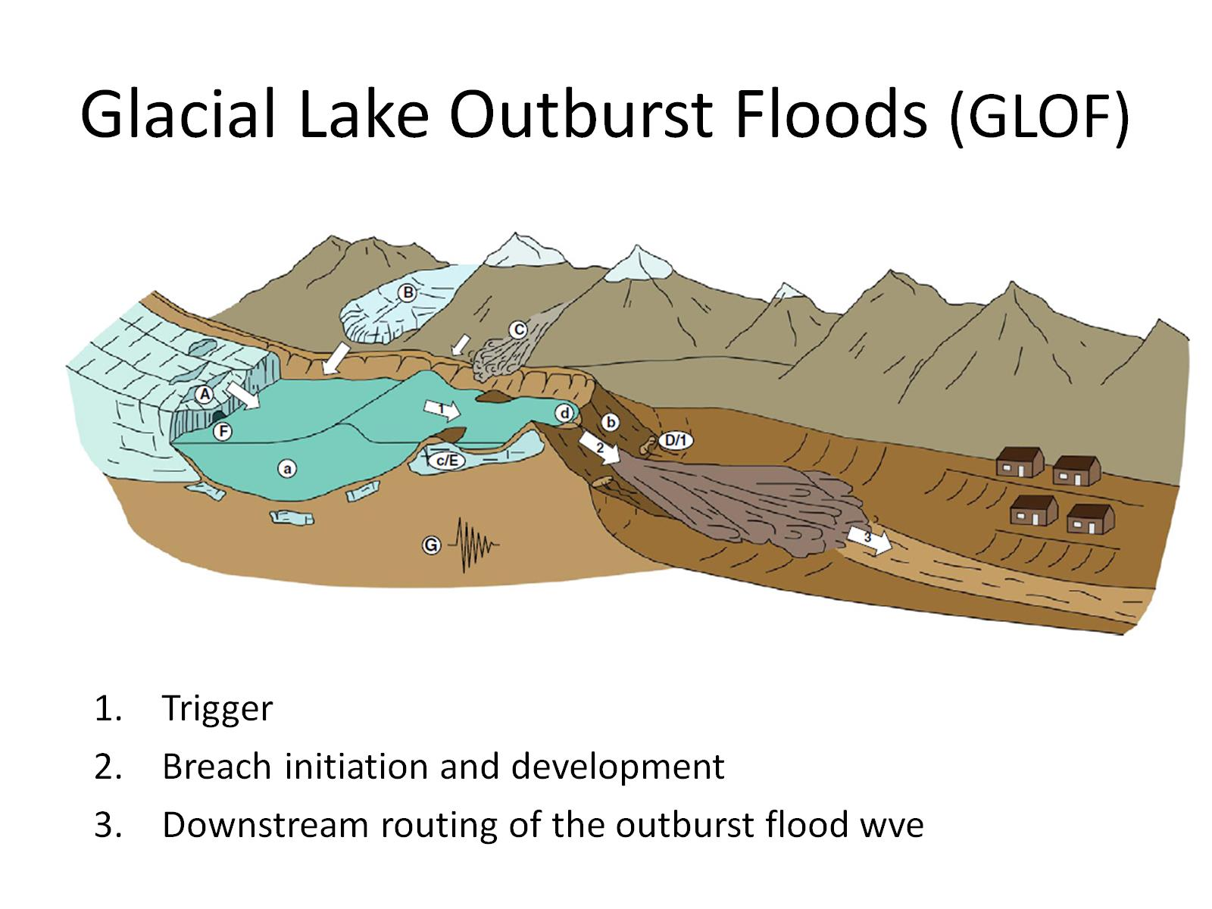
Glacial Lake Outburst Floods (GLOF)

Slide 28
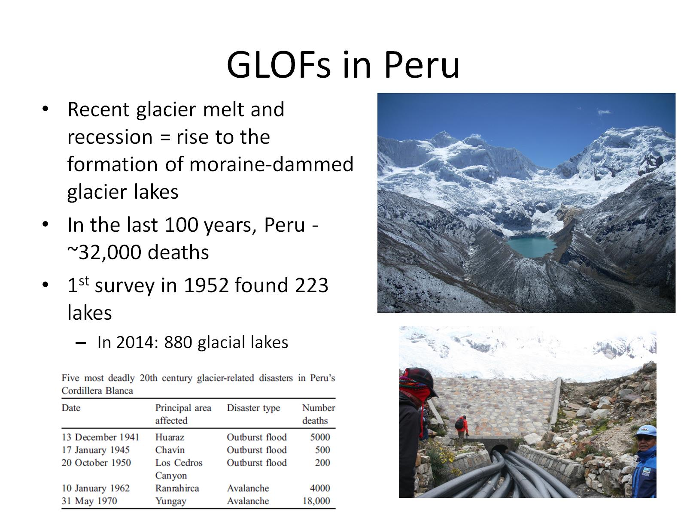
GLOFs in Peru

Slide 29
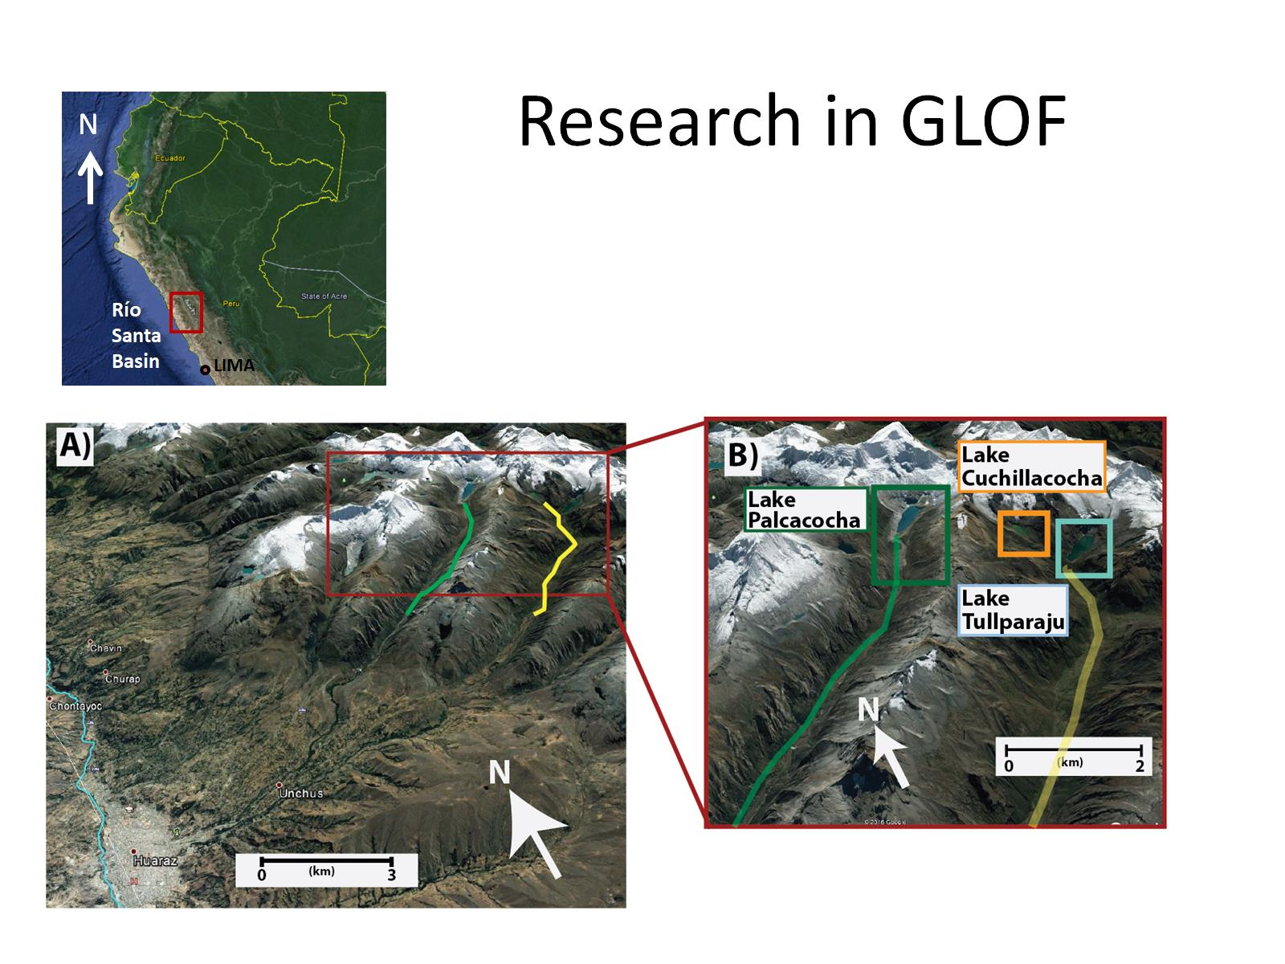
Research in GLOF

Slide 30
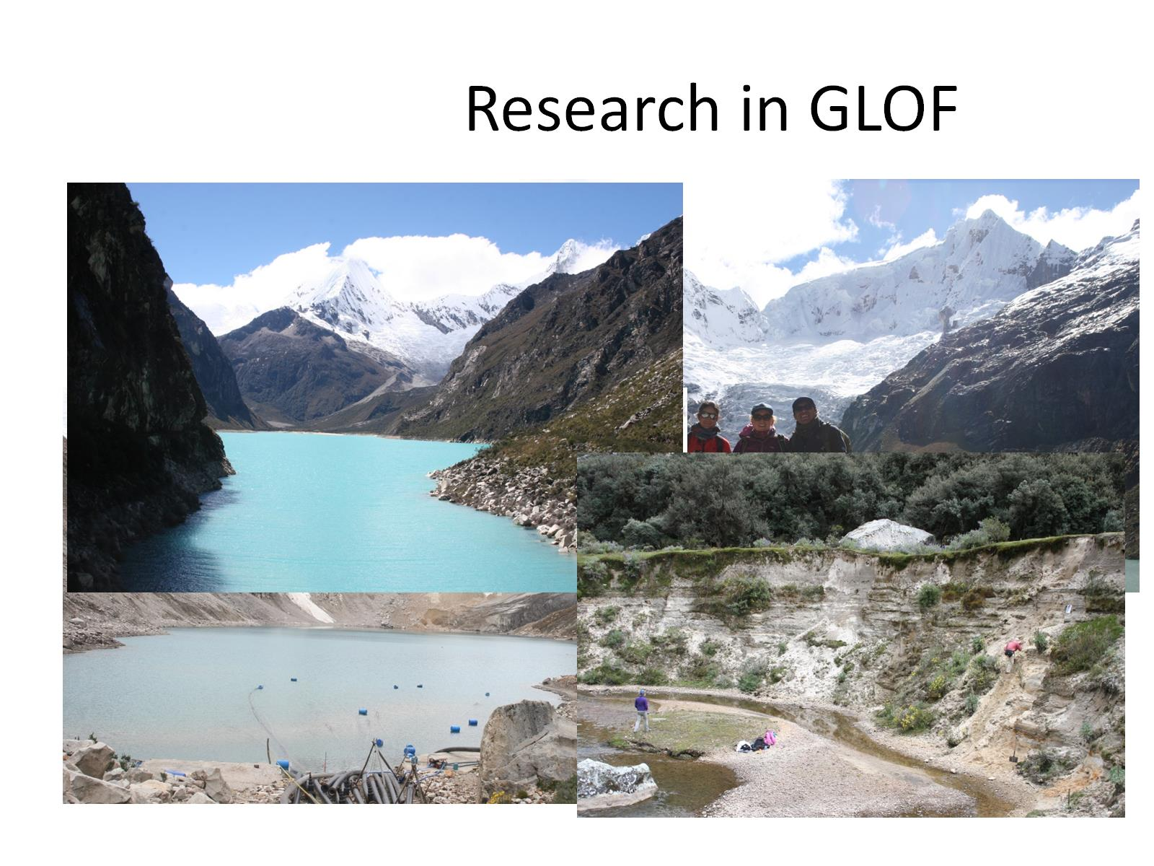

Slide 31
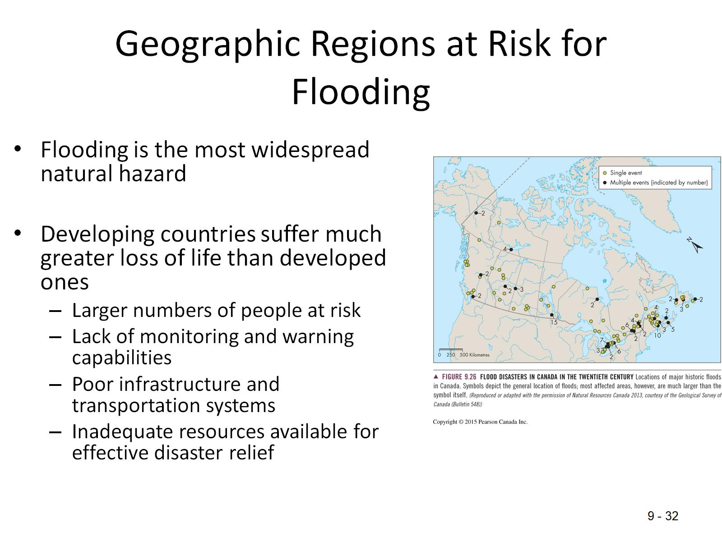
Geographic Regions at Risk for Flooding

Slide 32
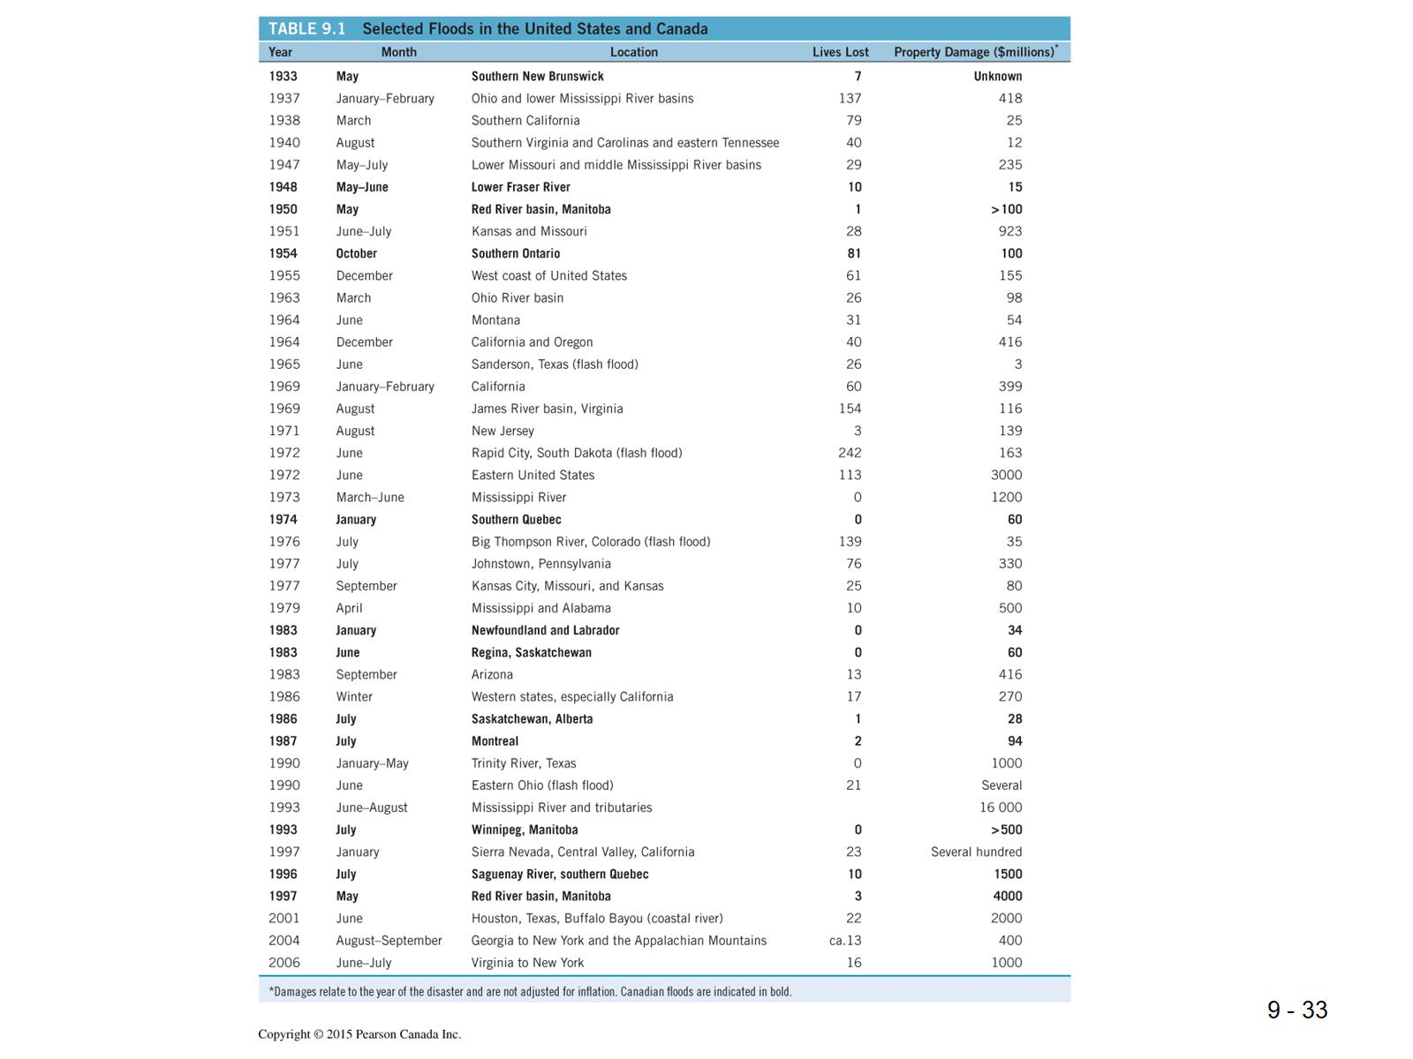

Slide 33
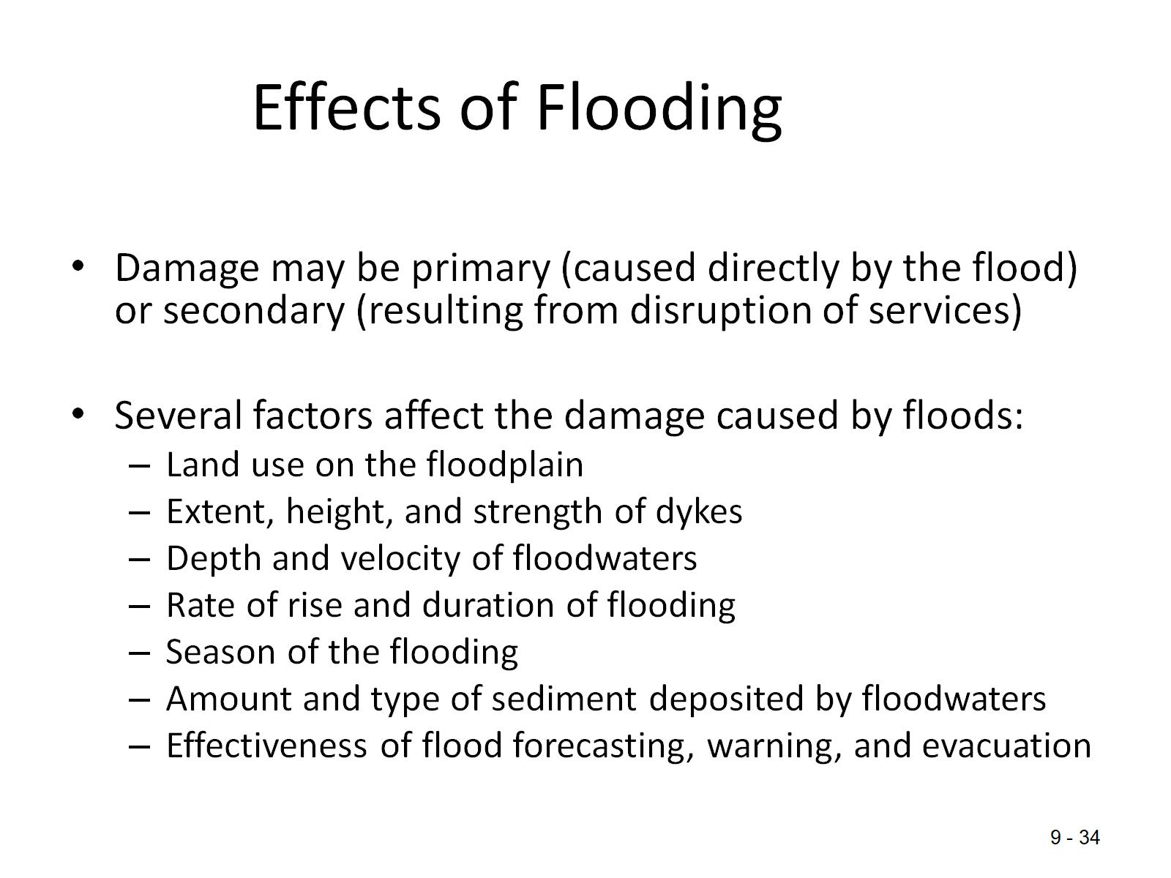
Effects of Flooding

Slide 34
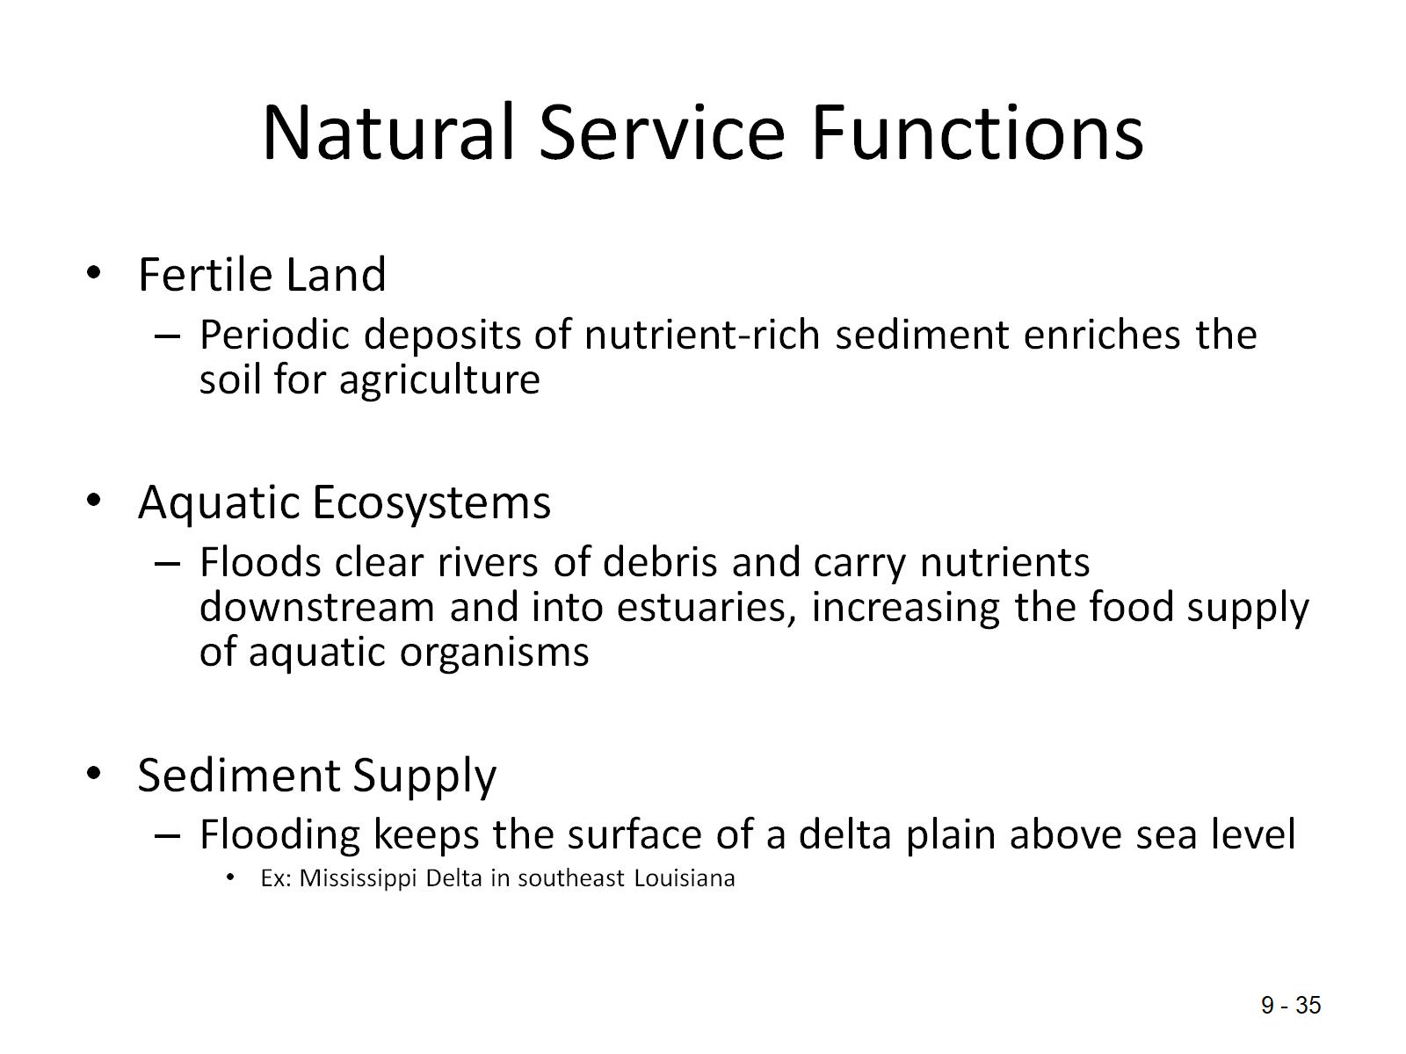
Natural Service Functions

Slide 35
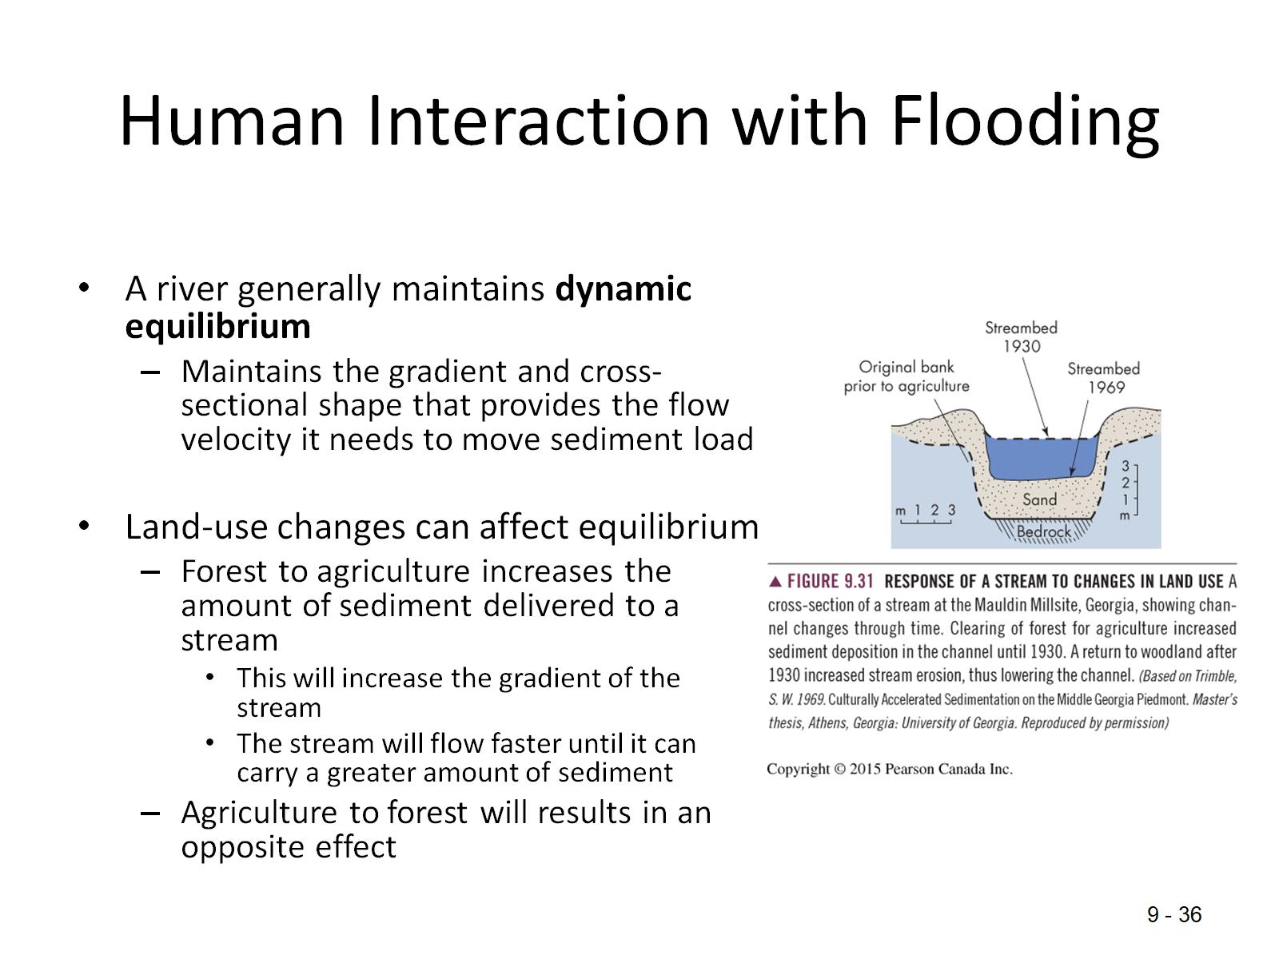
Human Interaction with Flooding

Slide 36
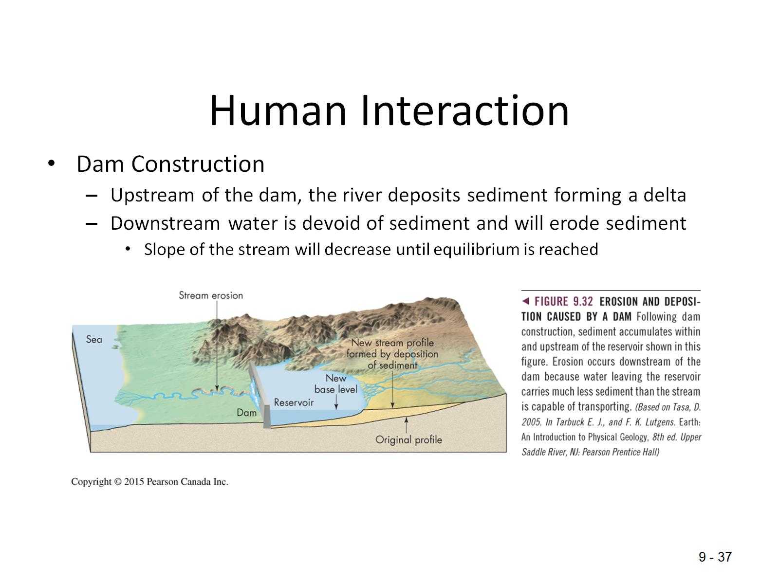
Human Interaction

Slide 37
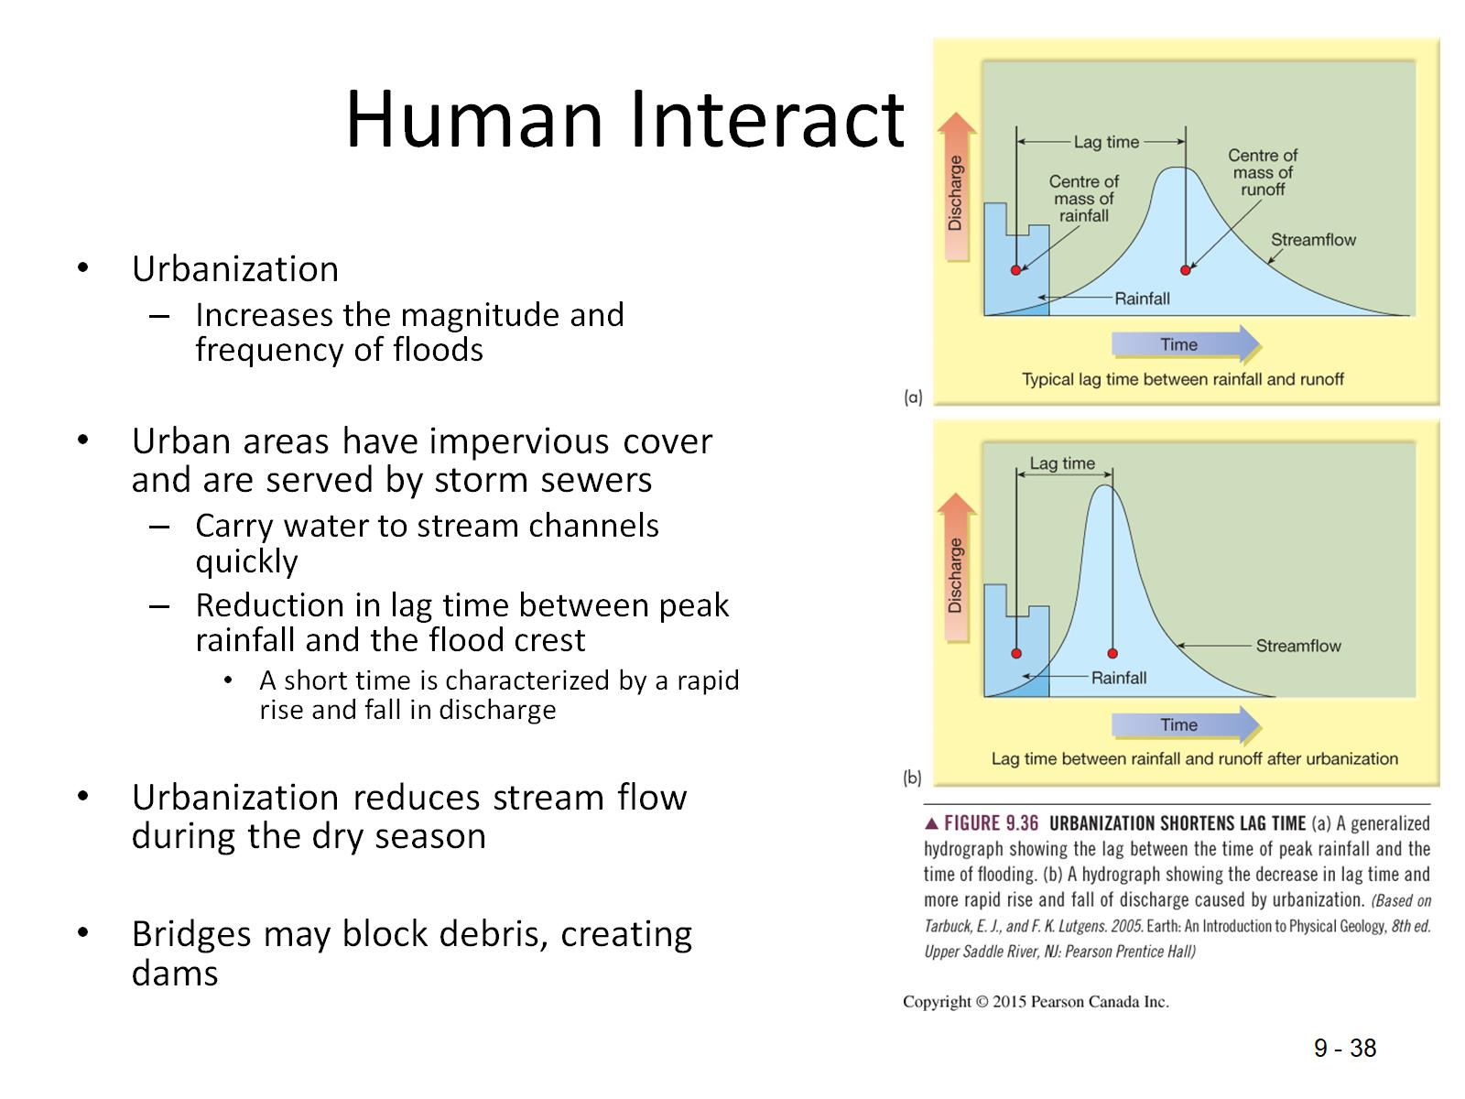
Human Interaction

Slide 38
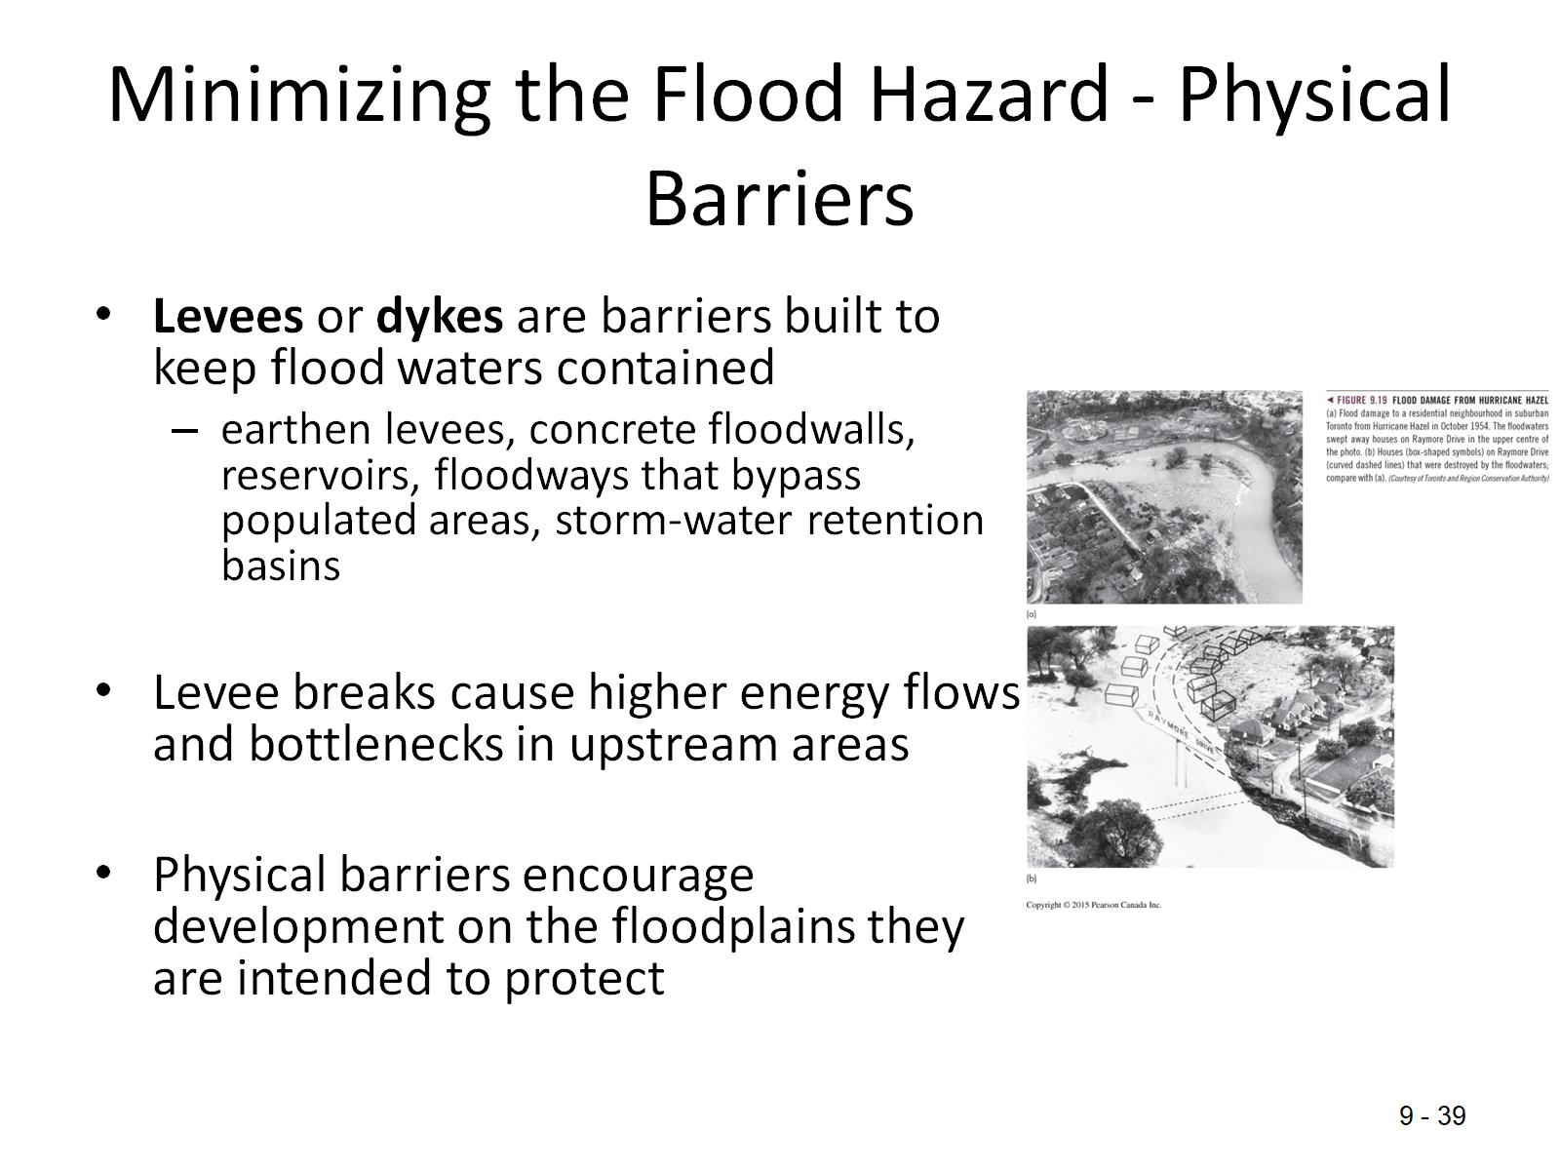
Minimizing the Flood Hazard - Physical Barriers

Slide 39
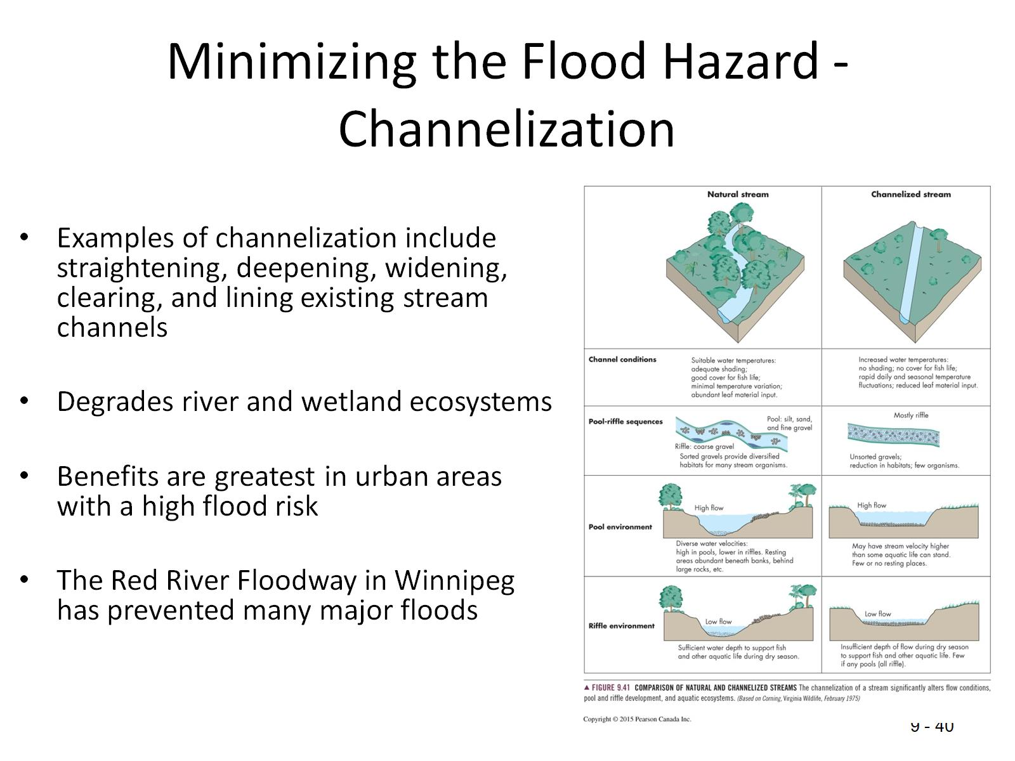
Minimizing the Flood Hazard - Channelization

Slide 40
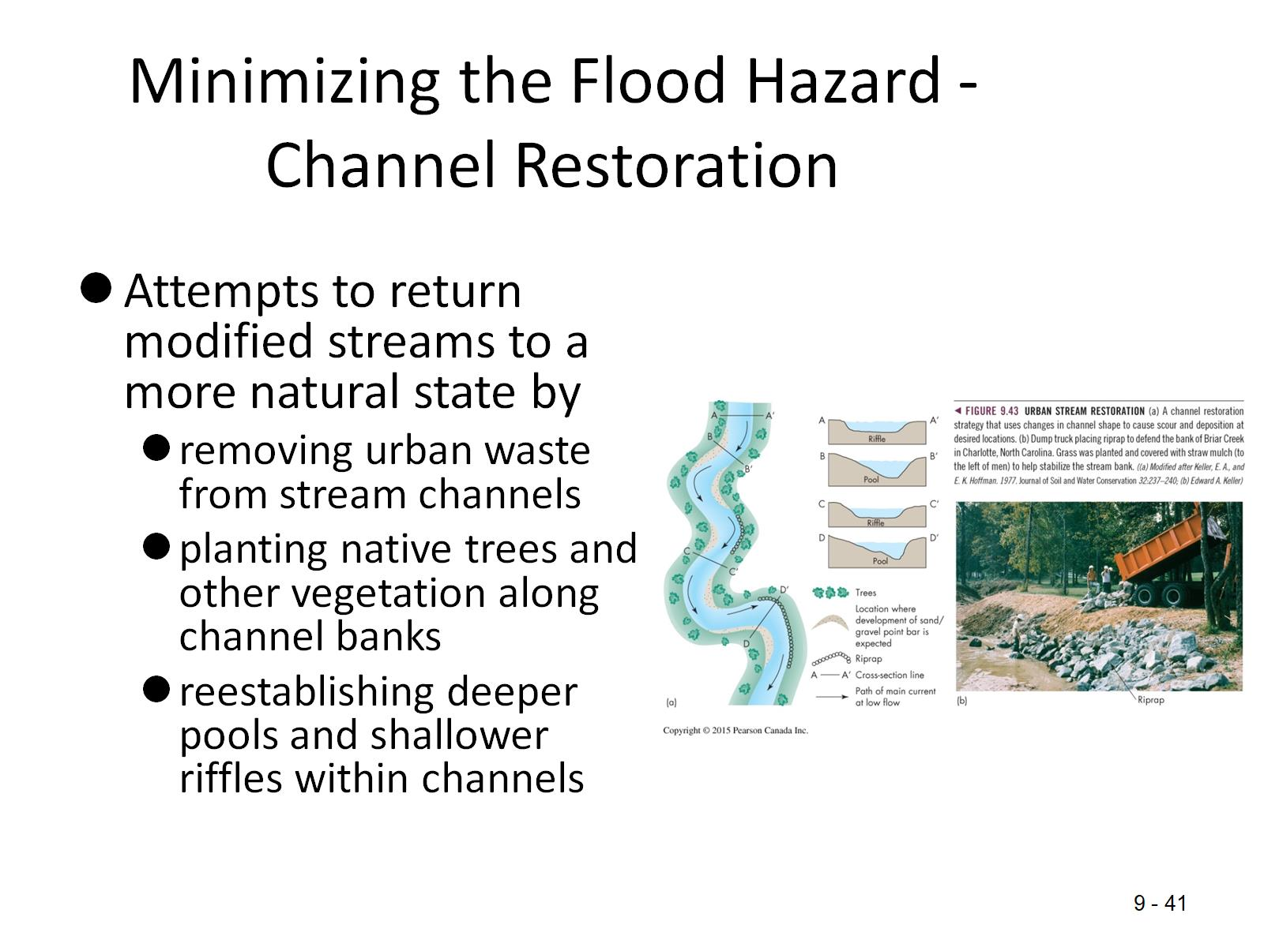
Minimizing the Flood Hazard - Channel Restoration

Slide 41
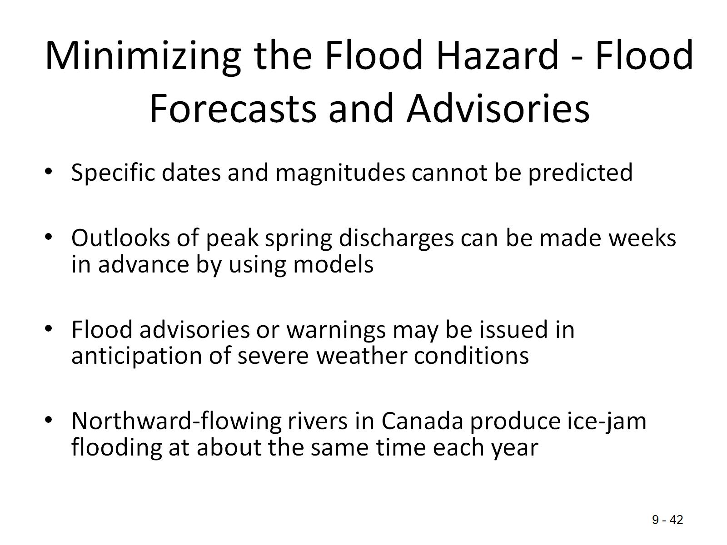
Minimizing the Flood Hazard - Flood Forecasts and Advisories

Slide 42
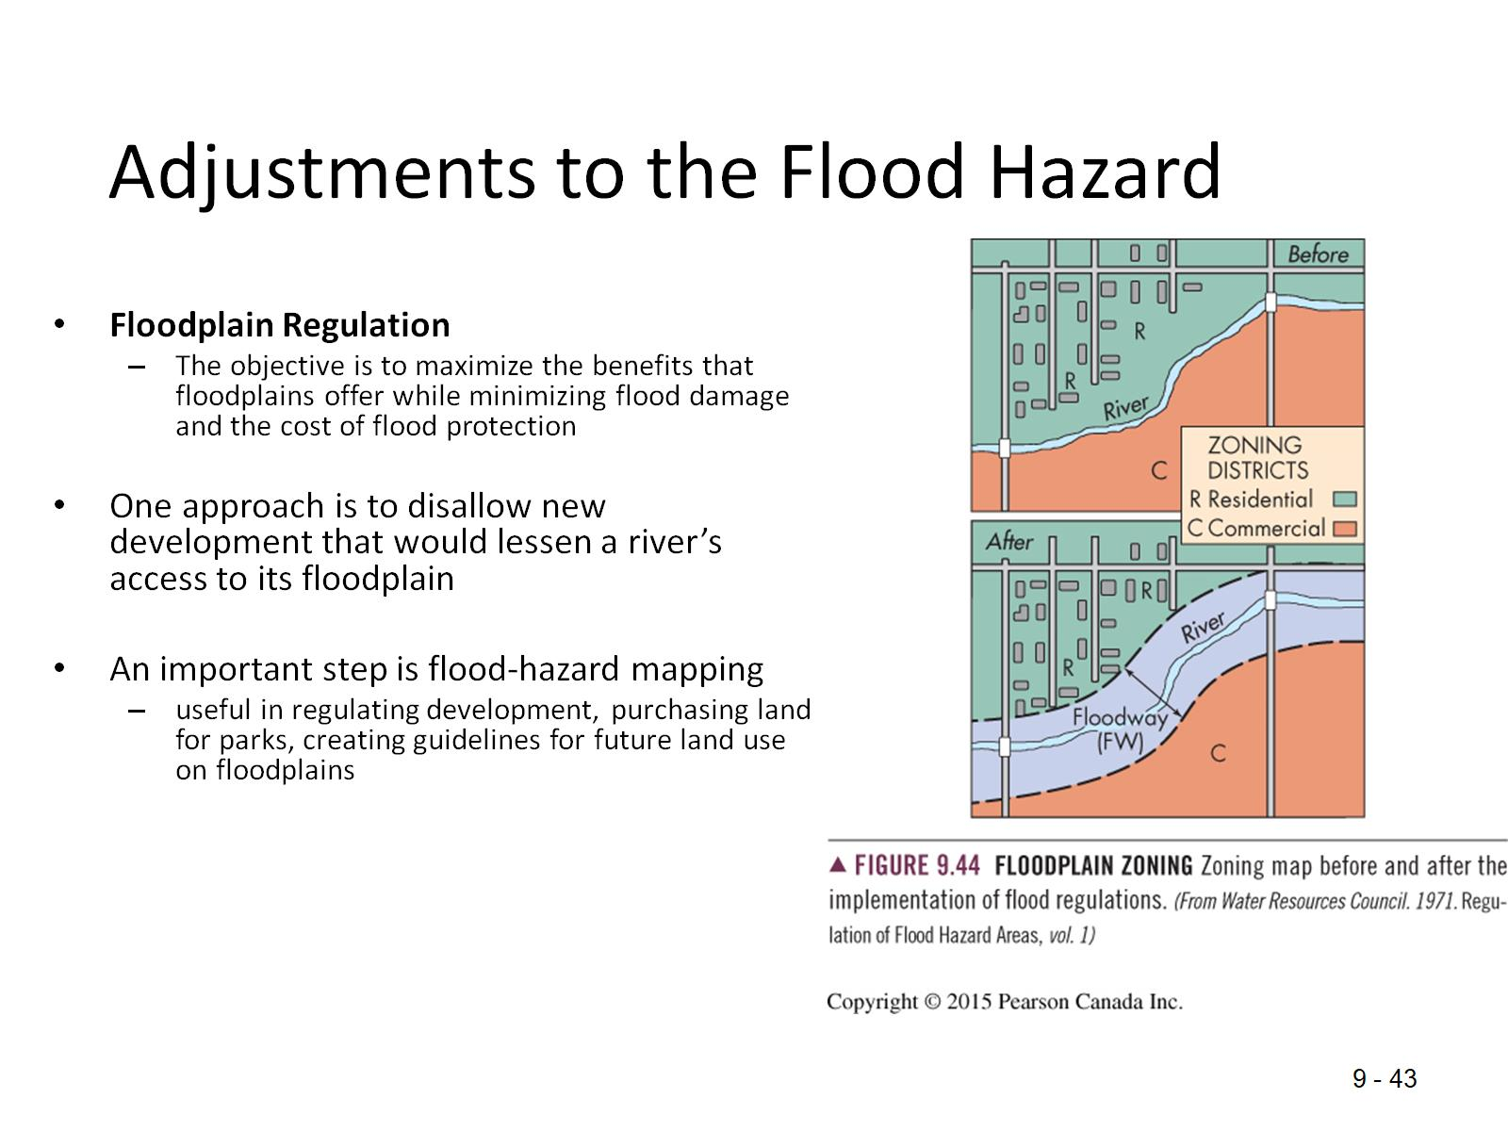
Adjustments to the Flood Hazard

Slide 43
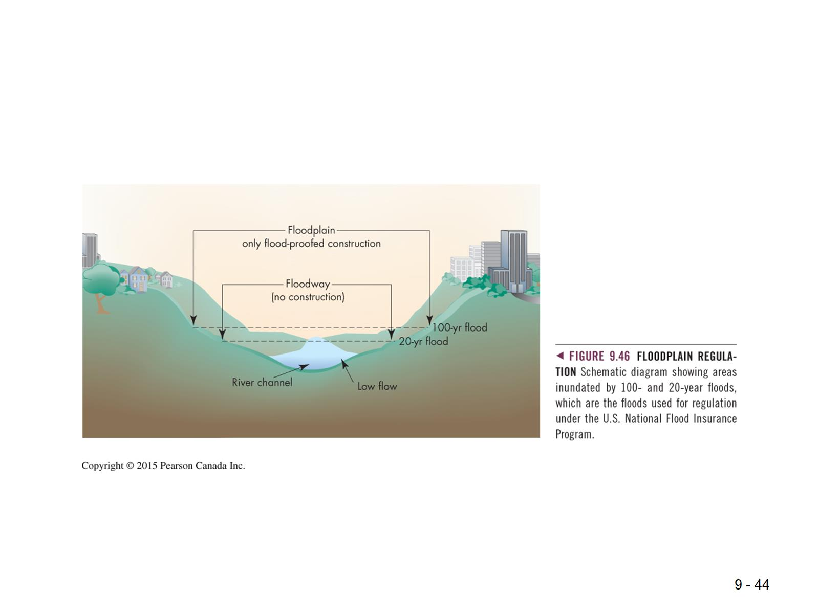

Slide 44
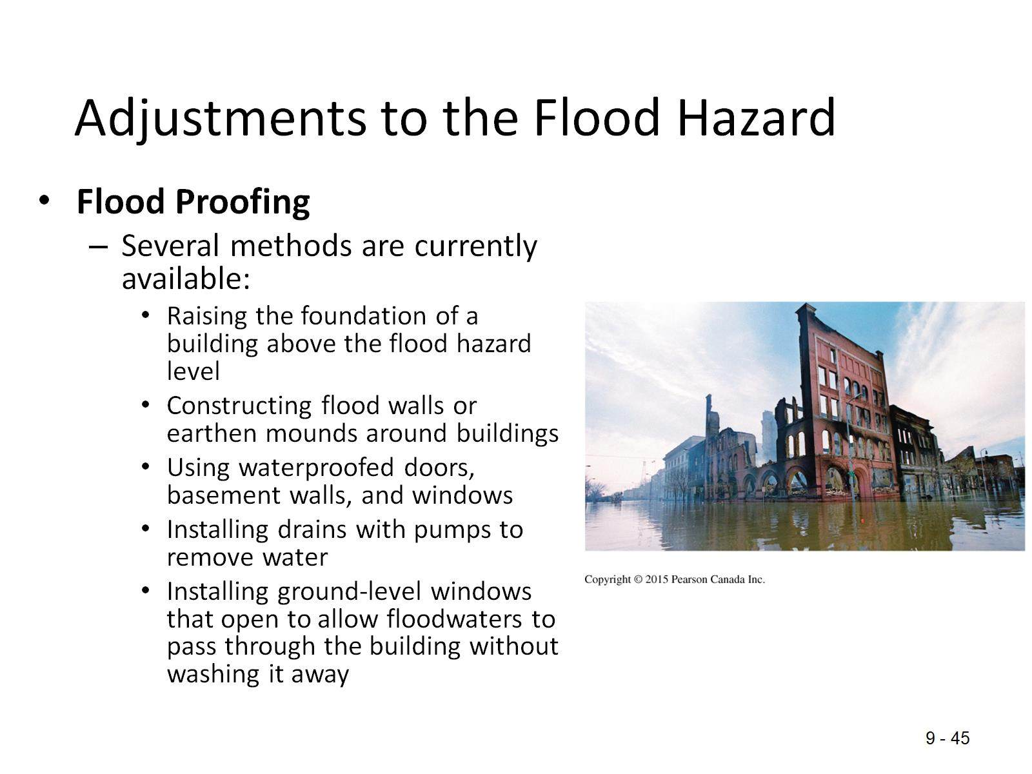
Adjustments to the Flood Hazard

Slide 45
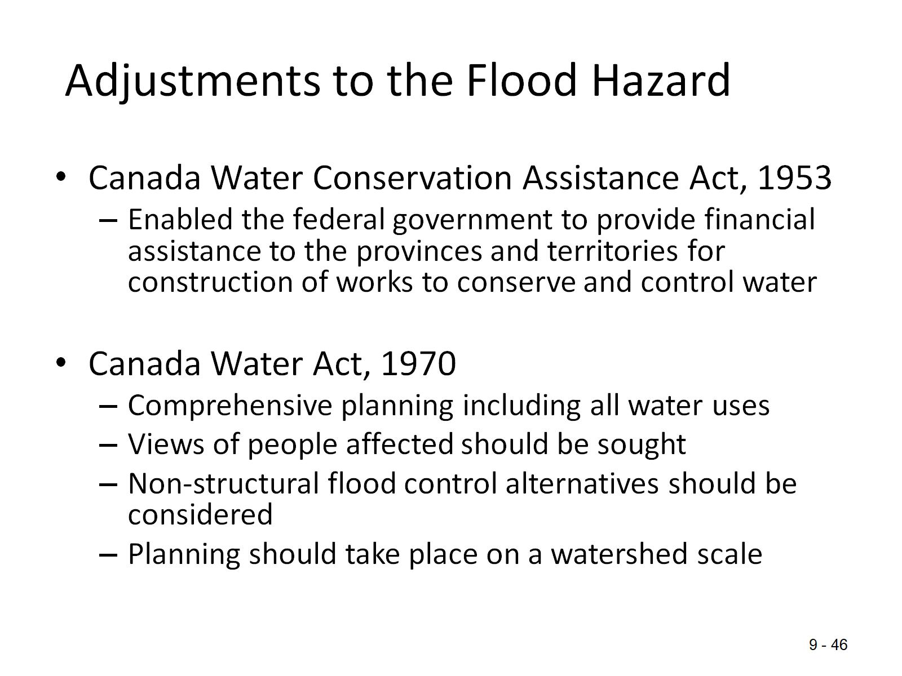
Adjustments to the Flood Hazard

Slide 46
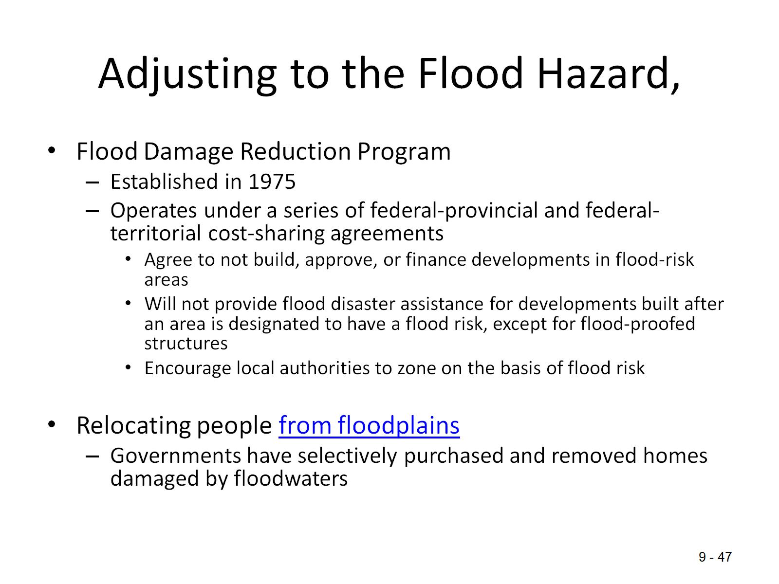
Adjusting to the Flood Hazard,

Slide 47
